Slide 1
On the Origins of Conjurations
DES313 – Jonah Unger, 2102791

Slide 2
Introduction
Name of Game | Developer | Year Published | Further Analysed
What Remains of Edith Finch | Giant Sparrow | 2017 | Yes
Gone Home | Fullbright Studios | 2013 | Yes
Myst: Masterpiece Edition | Cyan Games | 1999 | Yes
To the Moon | Freebird Games | 2011 | No
The Stanley Parable | Galactic Cafe | 2011 | No
Dear Esther | The Chinese Room | 2012 | No
In this portfolio, I highlight the research which informed the design and the resulting product that is my Player Experience Design prototype and presentation. The prototype is of a game of the walking-sim genre, with the working title of On the Origins of Conjurations (OOC).
My intended Player Experience (PX) focused on presenting a compelling and melancholic narrative; the challenge I gave myself was designing a game wherein the player learns about and forms an emotional connection with a character, without ever meeting said character. As an added challenge, and partially as a side effect of certain restrictions discussed later, I attempted to design this game with minimal visuals.
I took inspiration from multiple games with similar PXs (Right) but focused my analysis on three: What Remains of Edith Finch (2017), Gone Home (2013), and Myst: Masterpiece Edition (1999). Specifics of my PX design process and product will be explored in a later section; first I will go through a detailed analysis of these three games and their PXs. The categorisation of formal elements that will be discussed are informed by “Introduction to game analysis” (Fernández-Vara, 2019). The specific elements that will be discussed were chosen based on their importance to creating the PX of each game.

Slide 3
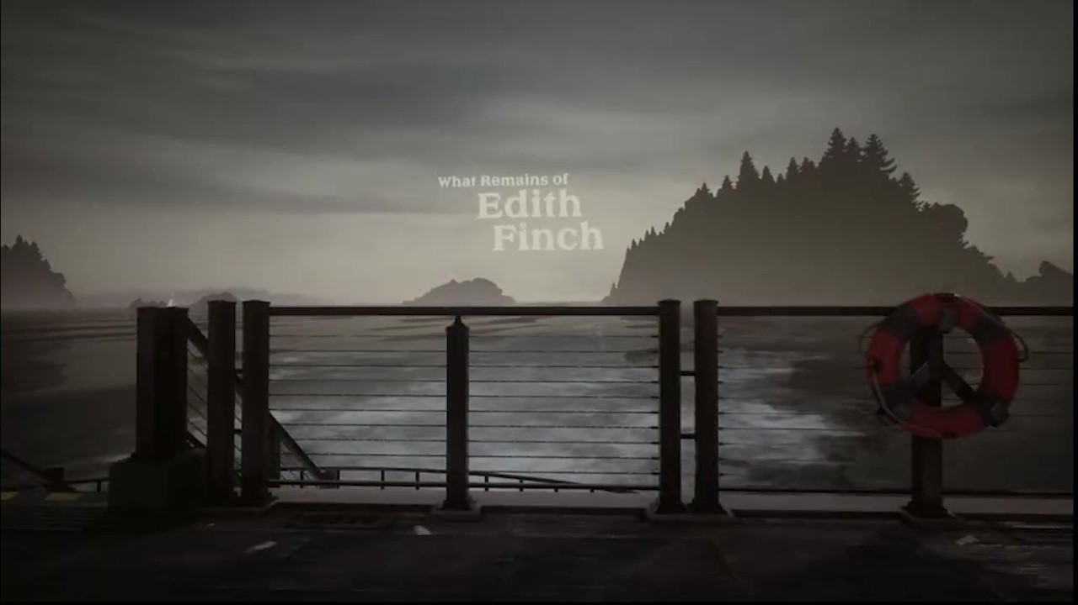
What Remains of Edith Finch
Context
What Remains of Edith Finch (henceforth WRoEF) is a “2017 mystery adventure video game” developed by Giant Sparrow and published by Annapurna Interactive (Giant Sparrow, 2019). The team consisted of about 160 people (Moby Games, n.d.). WRoEF has been extremely successful, with favourable reviews across multiple platforms (Metacritic, n.d.). The game centres around the eponymous Finch family and their home, with the player controlling Edith Finch, Jr., as she explores her ancestral home and learns of the many ways her extended family have died.
Giant Sparrow aims to give the player an experience that leaves them “humbled and astonished by the vast and unknowable world around us” (Giant Sparrow, 2019), and accomplishes this through the use of a variety of techniques and strategies. The specific elements we will discuss are narrative, mechanics, and gameplay experience and world (Fernández-Vara, 2019).
For this analysis, I have played through the entire game on PC, as well as sought out each Steam Achievement.

Slide 4
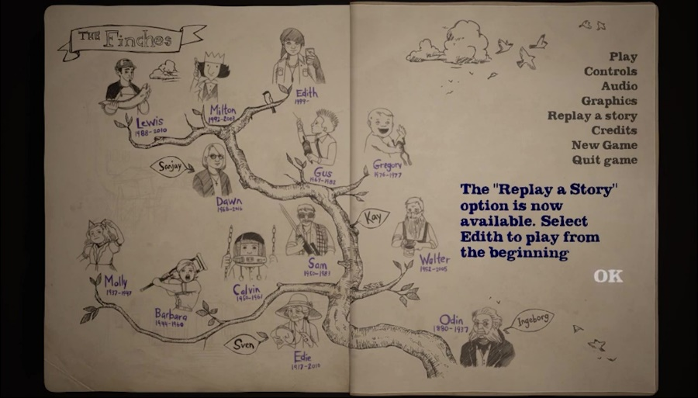
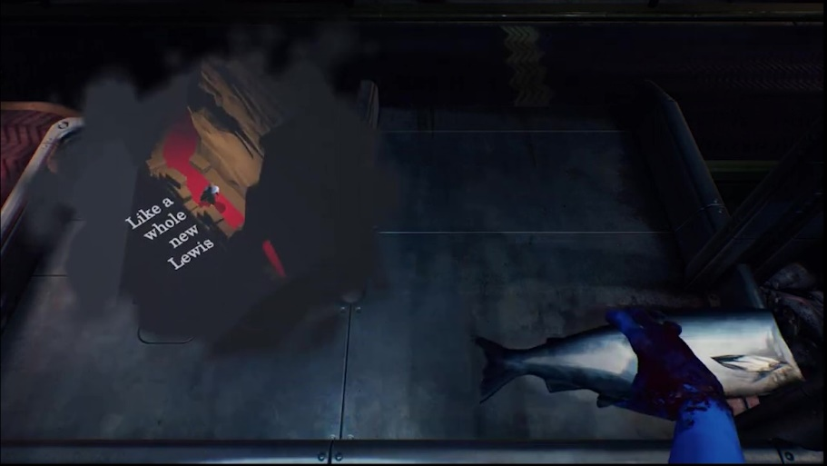
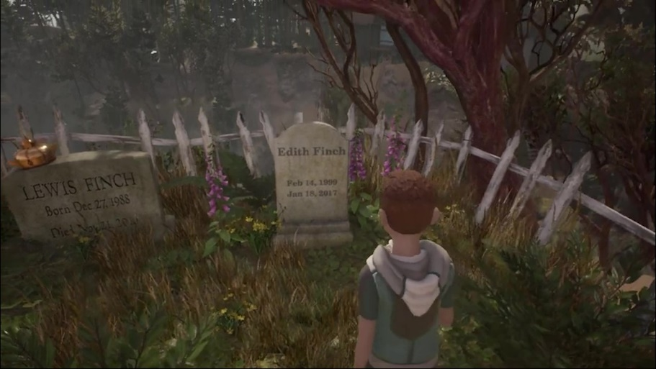
WRoEF: Overview - Narrative
This story follows that of Edith Finch, a young woman pregnant with her first child, as she explores her family home. The game is delivered through the frame of a journal Edith creates for her child, who is shown in both the beginning and ending cutscenes of the game.
The story of each Finch is told through either a level (for example in the cases of Lewis, Molly, and Gregory), or through a short piece of dialogue or visuals (such as in the cases of Odin and Sven). Each level is highly stylised, with their own unique aesthetic and gameplay mechanics.
The game ends once the player has played through the level and story of each Finch and ascended to the top of the house. Once there, Edith records how she and her mother left the Finch house, her mother’s eventual death, and Edith’s pregnancy. Through a final gameplay sequence and an ending cutscene, the player is shown that Edith died in childbirth, and the player sees Edith’s son, holding her journal, placing flowers on her grave.
The narrative proceeds as Edith journeys through the Finch House, a sprawling mansion with numerous locked rooms. As the last surviving Finch, Edith learns the stories of each of her deceased family members and records them in her journal.

Slide 5
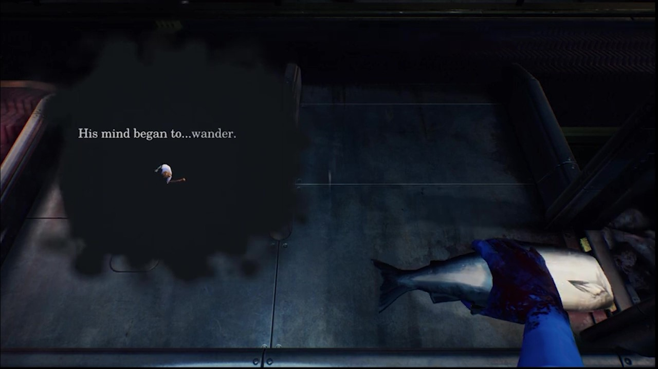
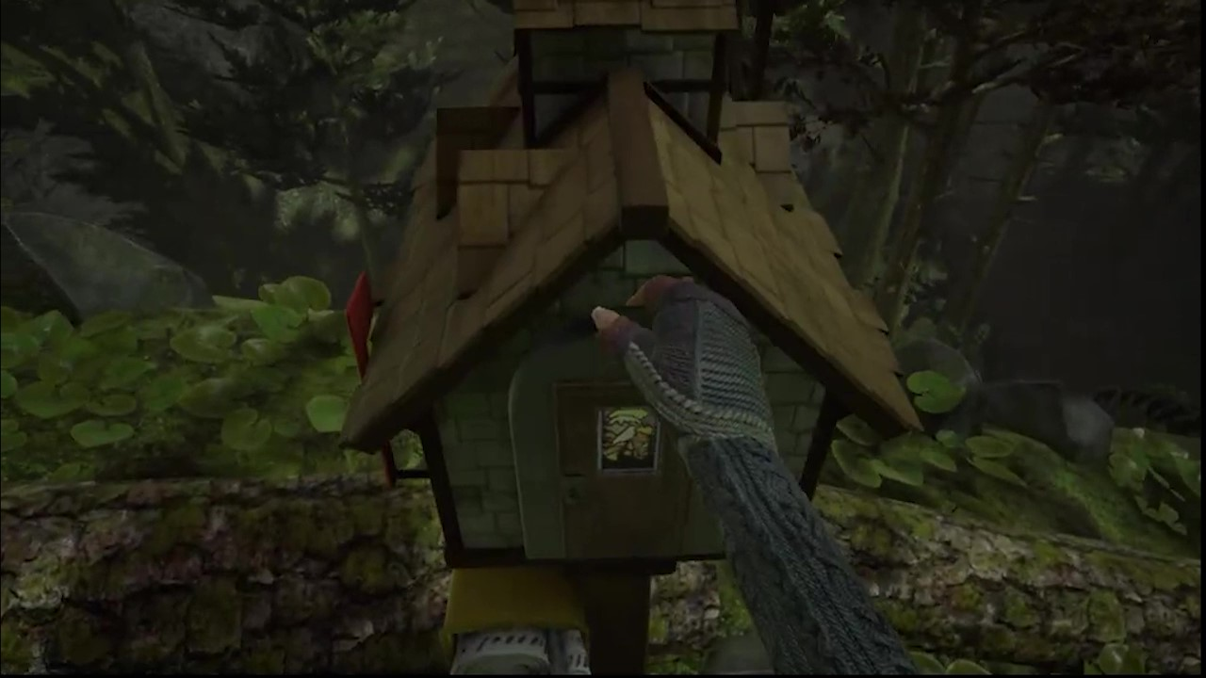
WRoEF: Overview - Mechanics
While the general mechanics are simple, each story level utilises those simple controls beautifully. In the story of Edith’s brother Lewis, you play as Lewis working in a fish cannery. With the mouse, the player controls Lewis’s right hand, removing the heads from fish. With the keyboard, the player navigates Lewis’s dreamworld.
The mechanics of What Remains of Edith Finch are simple, with the only controls available to the player being movement and object interaction. These consist of button prompts or occasional mouse control.
Apart from player controls, another important mechanical feature that contributes to the PX is the use of camera. During each story level the player is given a different perspective, and unique camera angles assist in creating immersive characters.
Certain elements draw the player further into the game, such as the ability to use the mouse to turn pages in a book, pull open drawers and doors, etc. In this way, the mouse becomes a stand-in for Edith’s hand, with the player physically pulling the mouse back to open a mailbox.

Slide 6
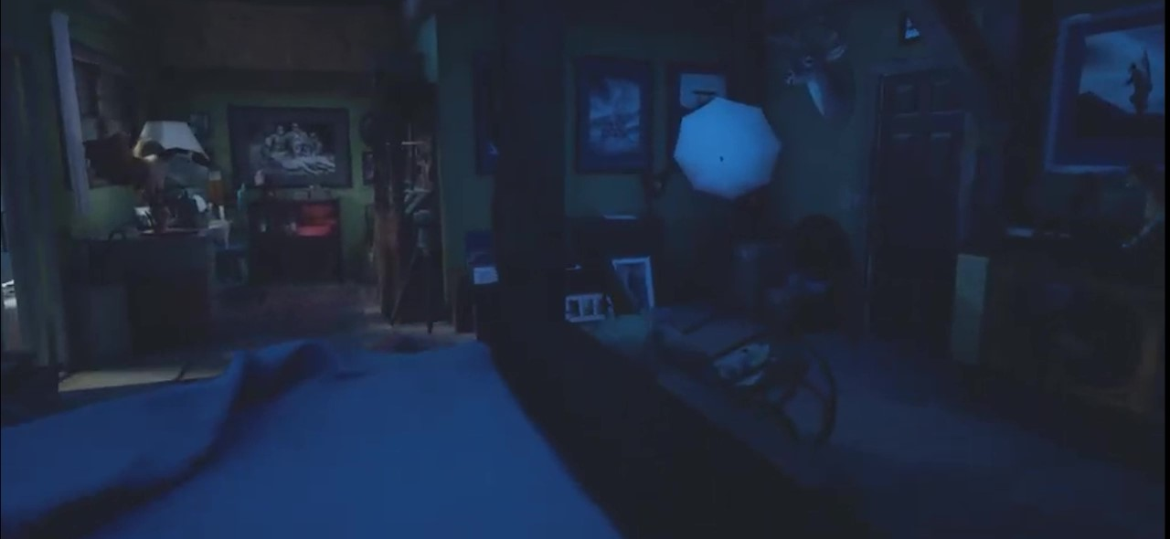
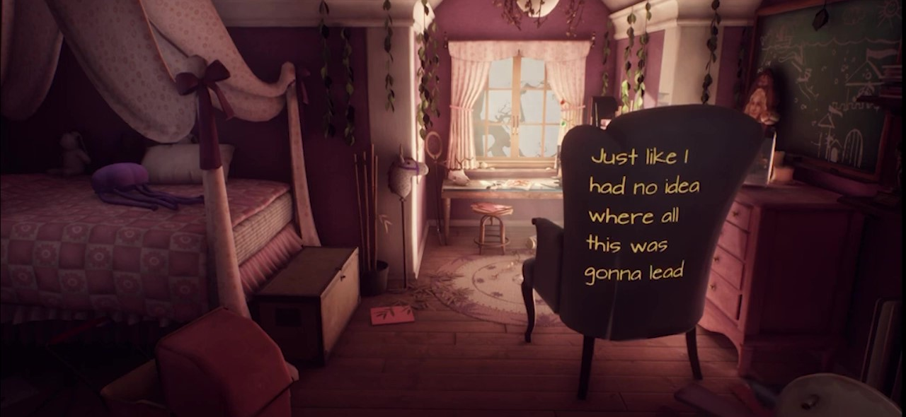
WRoEF: Overview — Gameplay Experience and World
Much of the narrative experience is delivered through atmosphere. The world of Edith Finch is incredibly immersive, with each character’s story having a unique feel built through colour, lighting, and sound. The house itself, in which most of the game takes place is cramped, cluttered, and cozy. Walls are lined with photographs and keepsakes, and each bedroom is highly personalised. The room of Edith’s grandfather, Sam, is filled with his hunting trophies, photography equipment, and hunting gear (Top). Molly’s bedroom is full of frills and cushions, a fairytale castle painted next to her bed (Bottom).

Slide 7
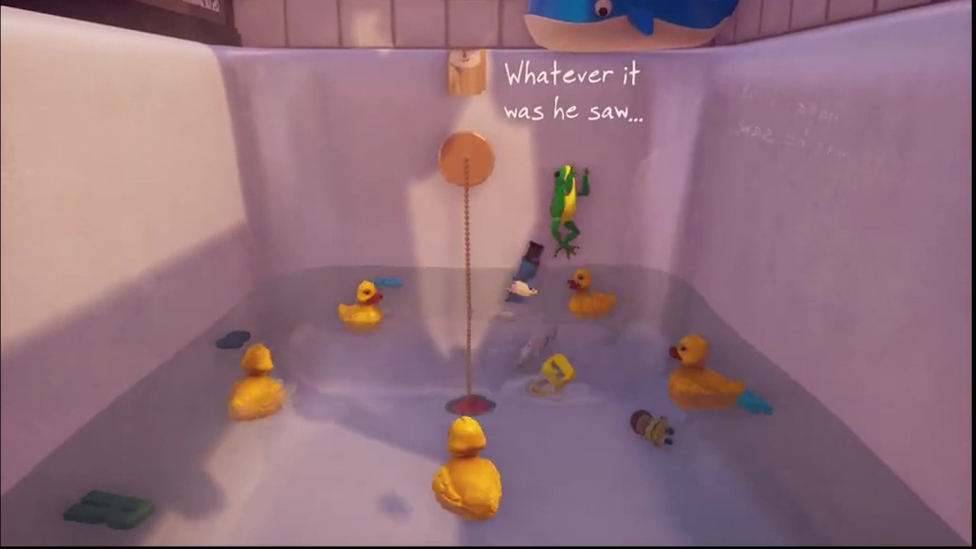
WRoEF: Overview - Gameplay Experience and World
WRoEF makes use of lighting, ambient audio, and music to establish and heighten emotions, building an atmospheric experience.
As the game progresses, the golden sun that had been shining through the seaward windows begins to fade, and by the time Edith makes her way up to her mother’s tower bedroom, the sun has set.
In the final gameplay scene, the player swims through a red, pulsing tunnel towards a light. The player hears breathing and a heartbeat surrounding them, as they realise that they are being born, surrounded by the floating letters of Edith’s last journal entries.
Music is used sparingly and impactfully. In one scene, Edith’s infant uncle Gregory is taking a bath when his mother leaves to take a phone call. Left alone in the half-full tub, Gregory imagines his bath toys coming to life and dancing to the tune of “Waltz of the Flowers,” from the Nutcracker Suite by Tchaikovsky.

Slide 8
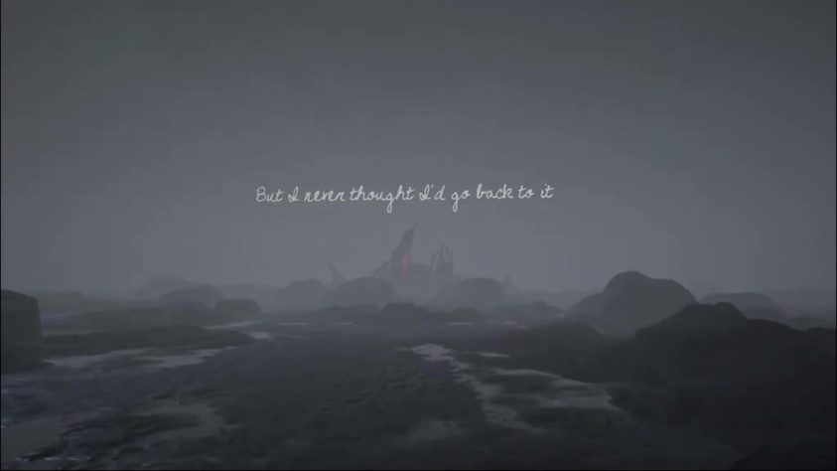
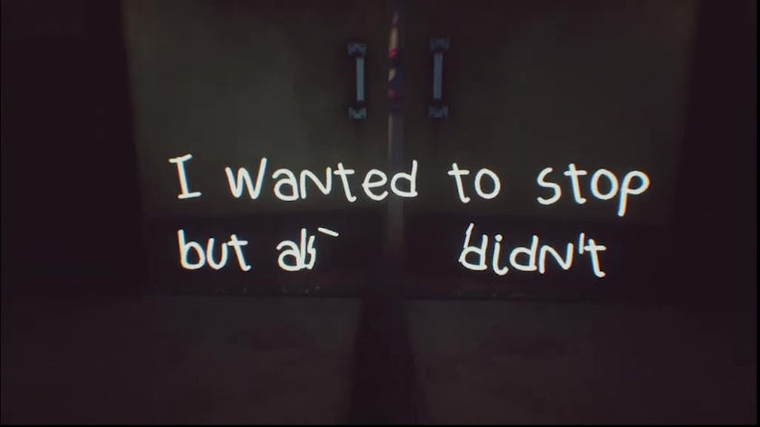
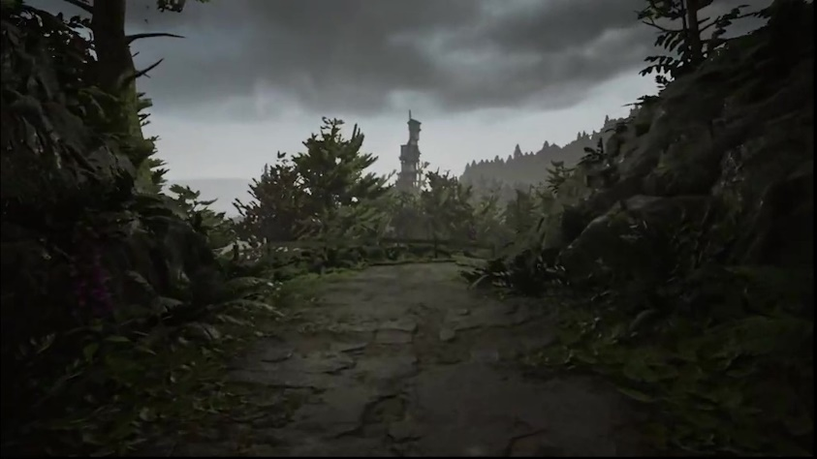
WRoEF: Analysis – Visual and Audio Design
As is the case in many games, lighting is used to point the direction the player should go (Fabricatore, 2007). For example, when first entering the second floor of the Finch house, glowing text will appear and float towards the player’s goal, a peephole in a door. In another instance, when the player is reading Grandma Edie’s journal near the end of the game, the player experiences a memory of Edie’s. Here the player is walking on a dried-up seabed towards a house, guided by a flashing red light.
Much of the PX of Edith Finch is influenced by the visual and audio design. In this section we will explore elements such as lighting, colours, camera and framing, music, voice acting, and environmental sounds.
Once inside the house, it becomes eerily quiet. The only sound other than the occasional narration is that of Edith’s footsteps. As each character’s story is encountered and completed, time progresses within the “real” world, that of Edith. By the end of the game, when Edith ascends a tower to her old bedroom, night has fallen.
Each “level” of the game is told from the perspective of and narrated by a unique character, with the various characters’ stories stitched together by segments where the player pilots Edith herself. The game does an excellent job of helping you to identify with the current Player Character (PC), through numerous means. For example, while pieces of narration are being spoken (I.e., journal entries being read), the words appear on in the world as floating text. This text is interactable and can on occasion be dispersed by the player colliding with it.
During the initial section of gameplay, the player as Edith Finch walks up a long, winding path through the woods to the Finch house. There is no music, only environmental sounds. This quietude is interspersed with Edith’s narration, as voiced by the talented Valerie Rose Lohman, who for this performance was nominated for a BAFTA award (IMDb, n.d.).

Slide 9
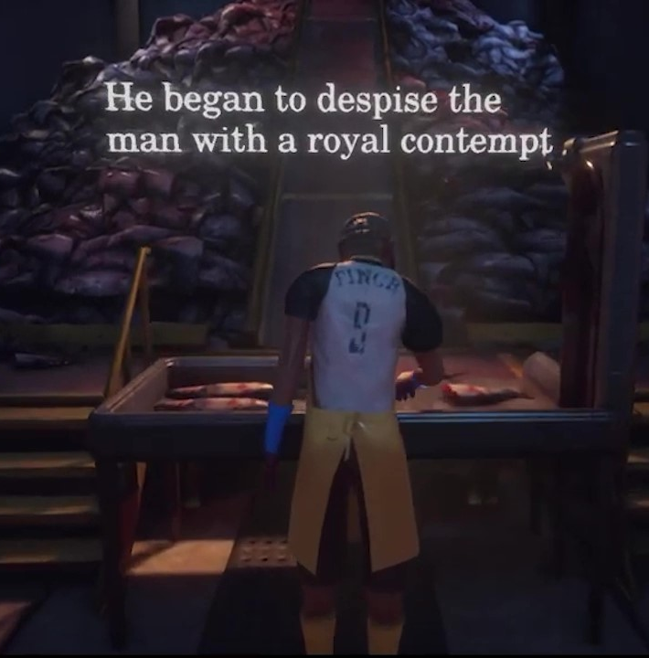
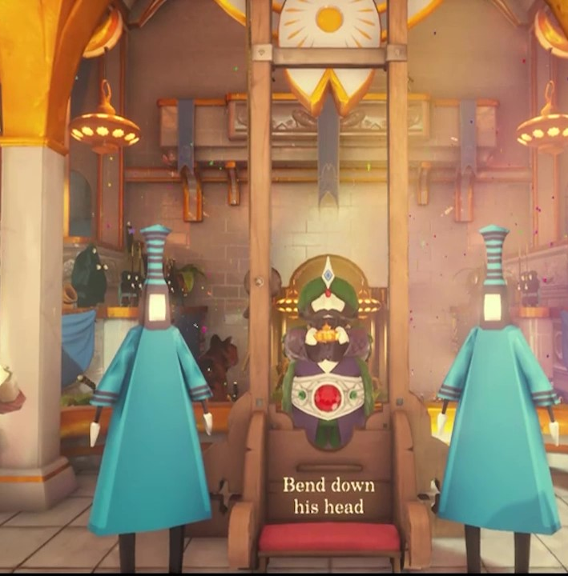
WRoEF: Analysis – Visual and Audio Design
The effects of lighting on emotion and PX are well documented (Seif El-Nasr et al., 2007), and certain lighting techniques are used to significant effect throughout Edith Finch. As mentioned previously, time progresses in line with the player’s progression through the Finch house. This not only lends a sense of time progressing, but also shows the player’s journey through the Finch family tree chronologically. Lighting and colour also used within each of the character’s story levels. For example, in the story of the infant Gregory, colours are saturated, lighting is bright and warm, and the entire world seems warm and welcoming (Left). In Lewis’s level, the fish cannery where he works is dirty, unwelcoming, uncomfortably real (Middle). However, his dream world is vibrant and alive, full of warm colours and soft sunshine, things that are lacking in his day-to-day life (Right).

Slide 10
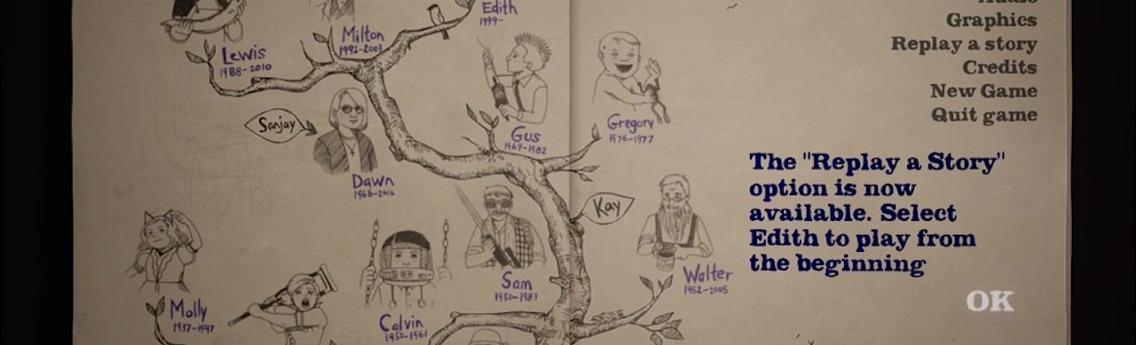
WRoEF: Analysis – Representation, Identity, and Mediation
Each of the characters that the player controls throughout WRoEF are fixed characters, or “characters [that] are defined by the development team, and players have no (or very few) options to change them” (Heussner et al., 2015, pg. 78).
The ability of the player to see the PC’s body in the periphery (looking down to the body or legs, seeing the hands interact with objects, etc.) allows for a greater sense of self (Fernández-Vara, 2019, pg. 162). The visual design, the movement, and the height of the different characters that the player controls throughout the game all help to provide a sense of character and reduce the barrier between the player and the character.
Another element that helps to reduce the cognitive dissonance between player and character is the HUD and UI, or lack thereof. When the game is first started, there is no main menu, no opening cutscene. You are immediately placed in control of a character (later revealed to be Edith’s son). There are few loading screens to break up the flow of gameplay, no health bars or mini maps to clutter the HUD, and the menu UI takes place in the wrapper of Edith’s notebook, with the level select being shown through the Finch family tree. This is a form of direct manipulation, a game design technique where “objects that can be manipulated are visible, and the player can aﬀect them immediately, in consecutive actions, and the player can see the eﬀect of the manipulation right away” (pg. 160, Fernández-Vara, 2019). The lack of UI and HUD elements allows the game to feel more “real,” creating less of a distinction or area of separation between the player and character.

Slide 11
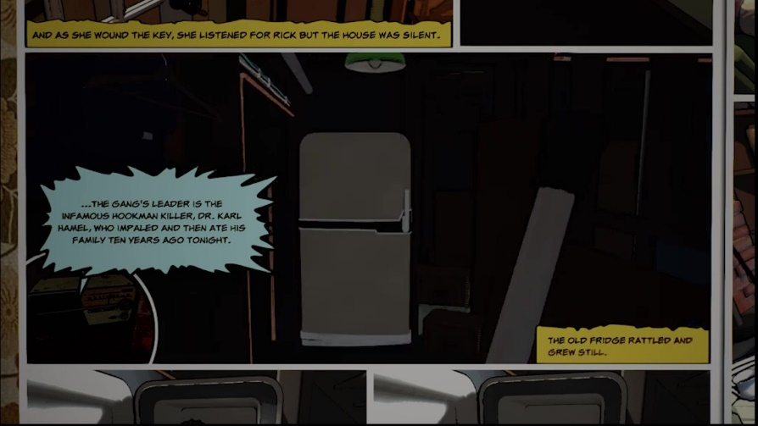
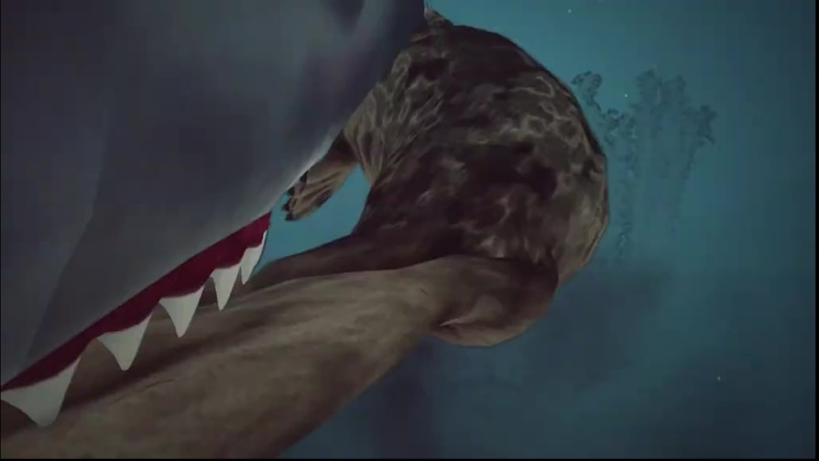
WRoEF: Summary
Takeaway | Description
Narrative Structure | “Corridor” Shaped Golden Path
Narrative Framing | Character Stories -> Edith’s Journal -> Edith’s Son reading Journal
Visuals | High-quality, emphasis on lighting
Player Character (PC) | Pre-defined
Average Playtime | 2-3 hours
Intractability | Relatively low amount of interactable objects
Inventory | No inventory
The Player Experience of What Remains of Edith Finch is one of exploration and of narrative immersion. The key methods WRoEF uses to convey its intended PX, as discussed above, are its visual and audio design and its focus on representation and mediation.
Each level or area of the game conveys distinct emotions through the use of lighting, colour, and sound. Music is used sparingly and with impact, unique camera angles, such as in the case of the stories of Barbara (Top) or Molly (Bottom) create tension or identity.
WRoEF creates a sense of representation through narrative, narration, and camera, firmly placing the player in the role of whichever Finch whose story they are currently exploring. While the inclusion of an entirely fixed PC allows for a more concrete identity for Edith, it may create a disconnect for some players who prefer another PC type, such as a cipher or blank slate (Heussner et al., 2015, pg. 78-790).

Slide 12
Gone Home
Context
Gone Home (GH) is “an interactive exploration simulator” developed and published by Fullbright Games (Fullbright Games, n.d.). Lead designer Steve Gaynor has stated that, at its core, GH is about family (Alexander, 2013). It focuses on the story of a young college student returning home from travelling internationally, to find her home empty. A highly environmental game, the player pieces together the story of the Greenbriar family by inspecting objects and documents, unlocking new areas of the house, and solving simple puzzles. The goals of the game are implied, with no explicit quests or milestones.
Fullbright Games was founded by three former employees of 2K Games who had worked together on the Bioshock series (Mahardy, 2013).
GH is also credited with helping to revitalise and popularise the “walking simulation” or “walking sim” genre of games, which contains games such as Dear Esther (2012). GH was controversial upon its release, partially because of its queer narrative themes, and partially because of its lack of traditional “gameplay” elements (Carpenter, 2019). Many criticise the walking sim genre for being boring, lazy, or “not games” (Korfhage, 2015). However, this portfolio will demonstrate how GH was able to create an impression through environmental storytelling, simple gameplay, an interesting narrative, and atmosphere.

Slide 13
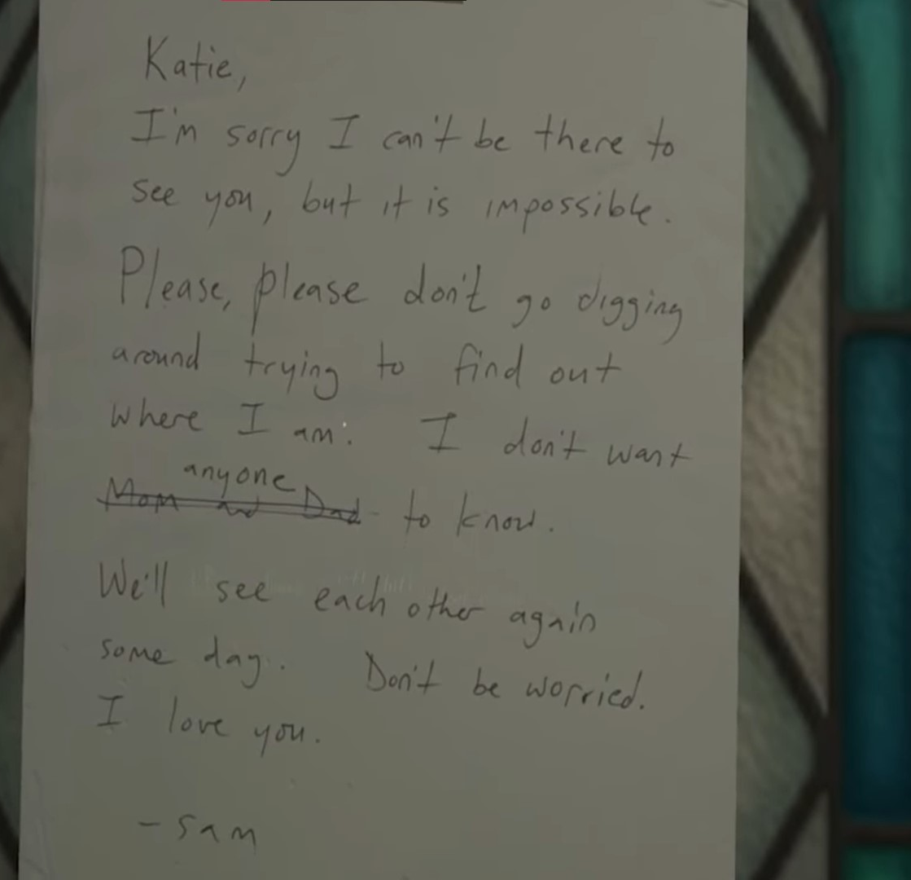
GH: Overview - Narrative
The game begins with a brief introduction in the form of a phone call from the PC, stating they will be flying in late at night. Gameplay then begins with the player on the front porch of a house, next to their luggage. The basic controls are introduced, such as movement, zooming in to read text, and picking up and inspecting objects. A note on the door, as well as the tag on their luggage, inform the player they are “Katie Greenbriar.” The note tells the player that someone named Sam, presumably the player’s sibling, has left home hastily, and tells the player not to go “digging around.”

Slide 14
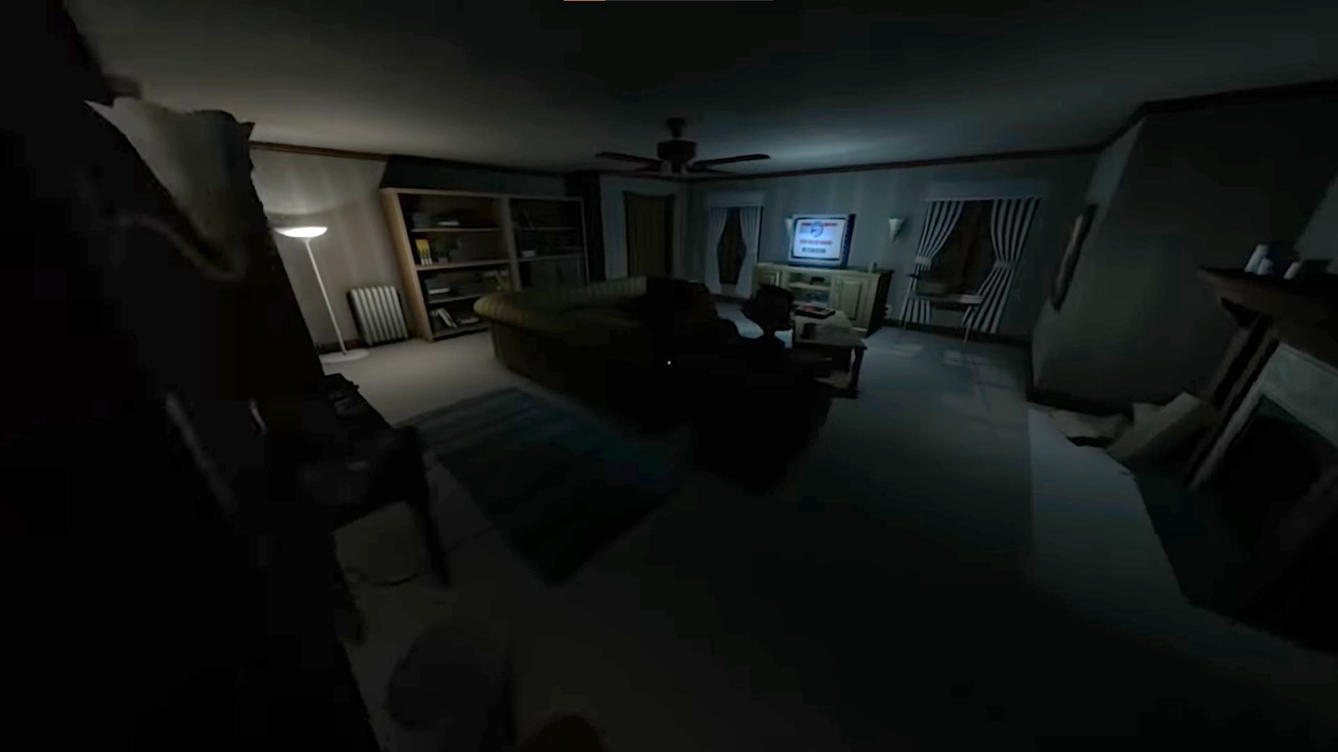
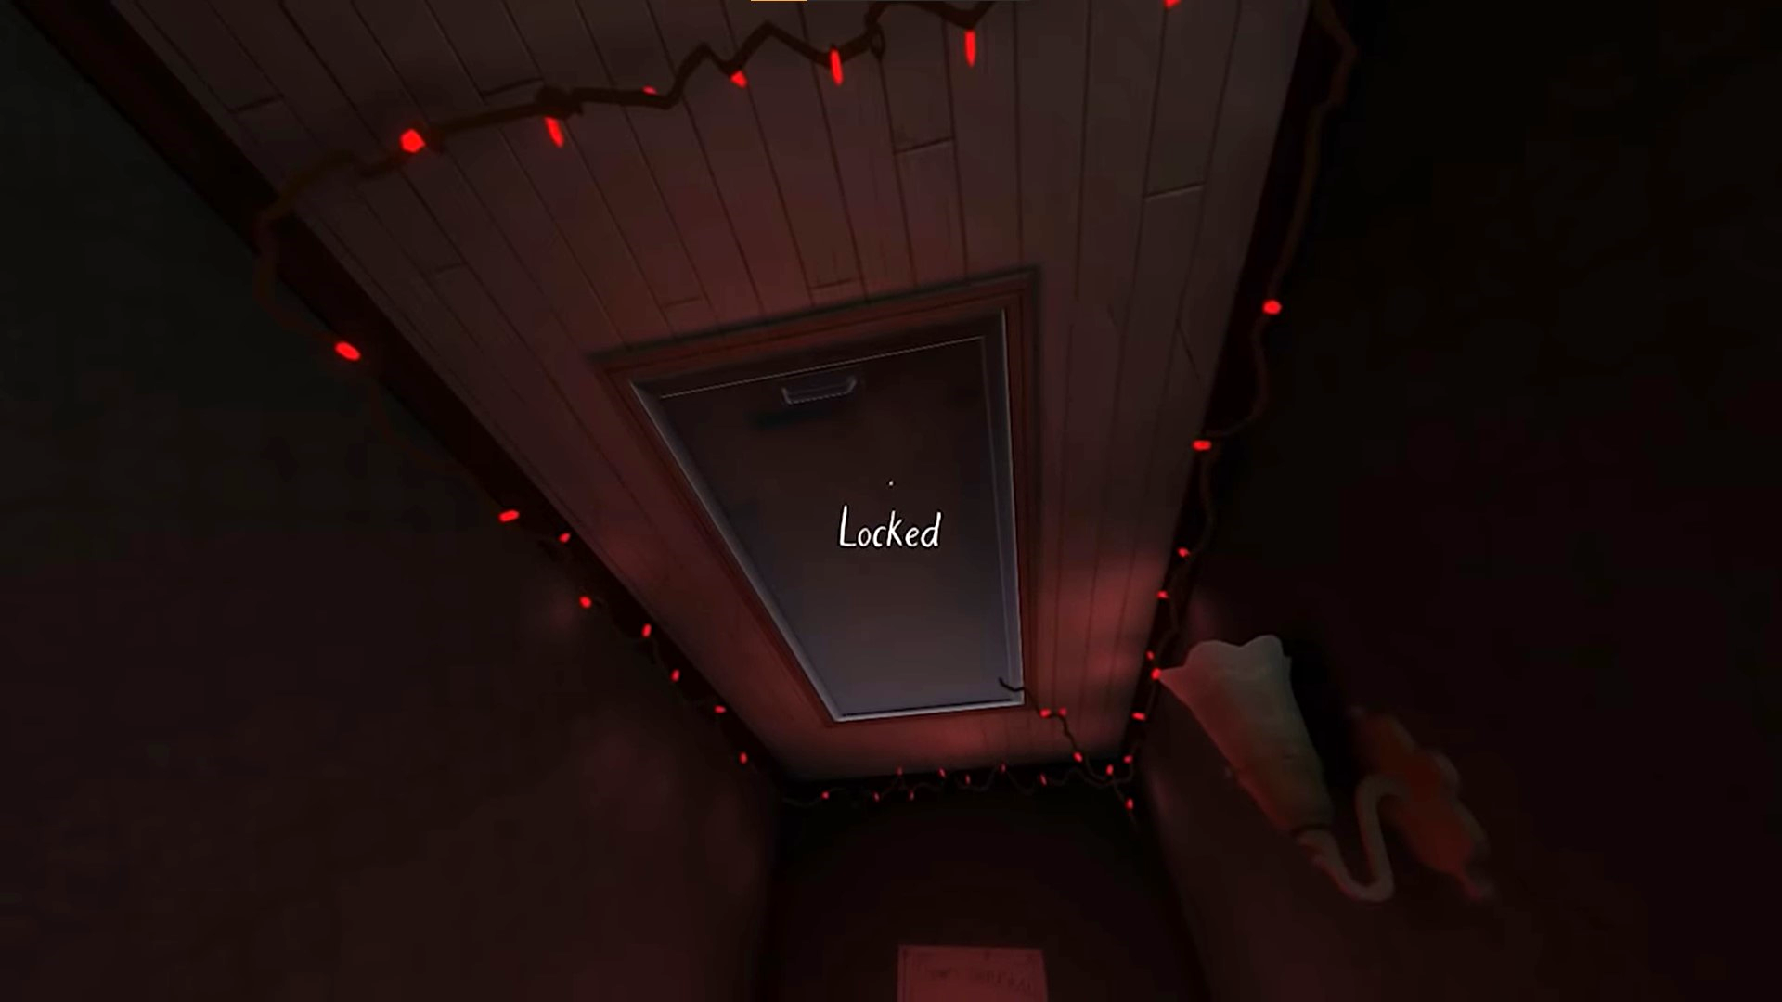
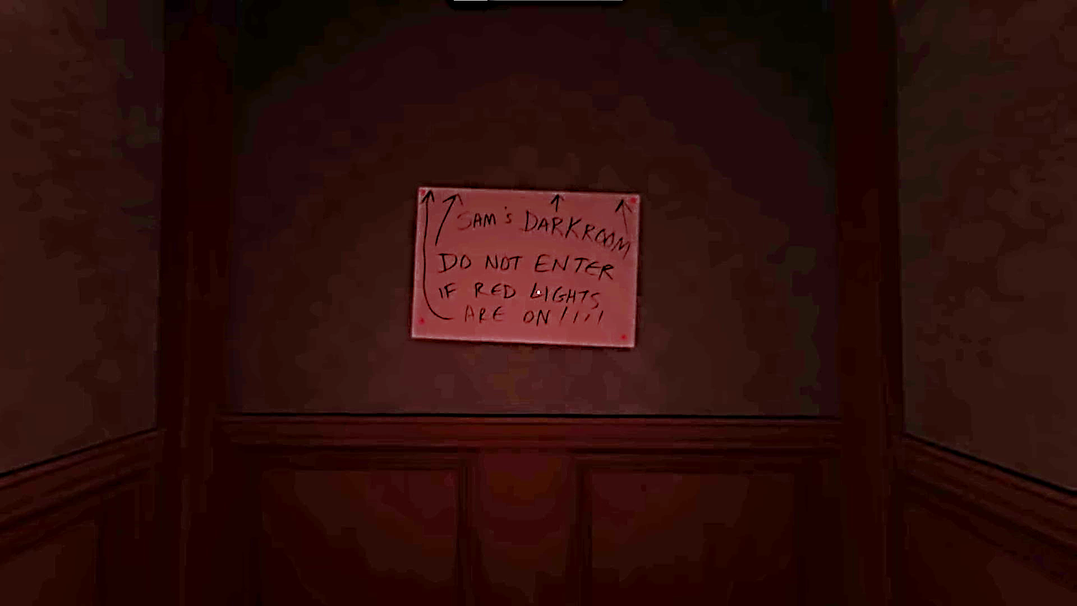
GH: Overview - Narrative
Directly inside the house is an invoice for moving costs. Upon reading the invoice, a journal from Sam plays. This reveals that Sam is the player’s younger sister, and that the PC, Katie, has been travelling abroad for some time.
Through environmental elements around the house, the player can piece together a narrative and cast of characters. Gameplay is freeform, allowing the player to encounter the narrative non-sequentially. However, certain parts of the narrative are locked behind doors that will need to be unlocked and puzzles that will need to be solved.

Slide 15
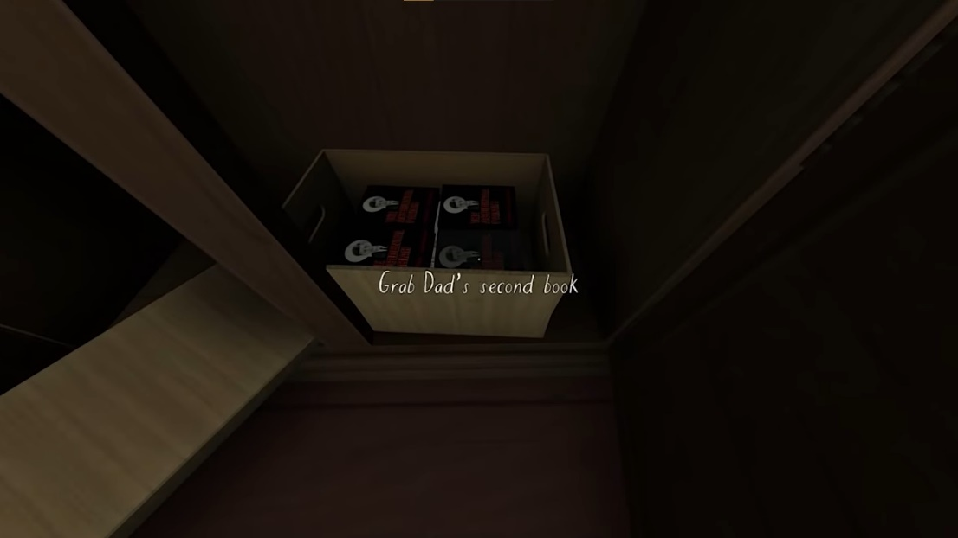
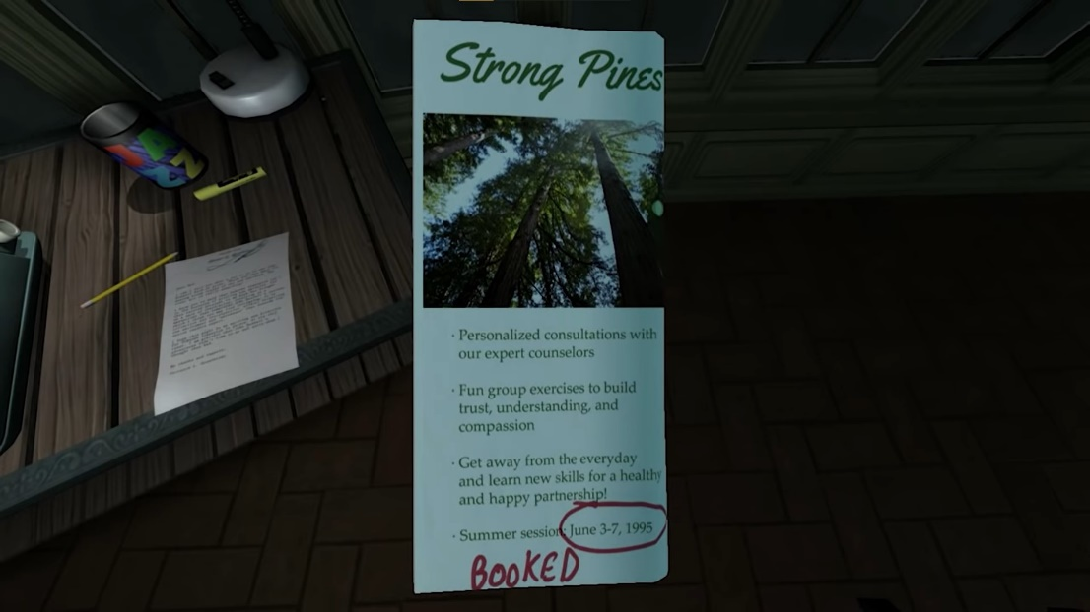
GH: Overview - Narrative
GH focuses on environmental storytelling. For example, stories written by Sam about a pirate captain and her first mate can be found around the house, with the earliest written during early childhood (Left) and the most recent being shortly before the events of the game.
The Greenbriar father, Terrance, was a crime and political thriller author, who was attempting to write a series. He had minor success with his first book, but struggled getting the second to sell; thus, the boxes of leftover books scattered around the house (Top).
Katie and Sam’s mother, Janice, works at the State Forestry Service. Her relationship with her husband Terrance is strained, even more so when Janice begins to develop feelings for a new coworker. She and Terrance attempt to repair their relationship, which is evidenced by marriage counselling receipts and books found around the house. They are attending a retreat when the player arrives (Bottom).

Slide 16
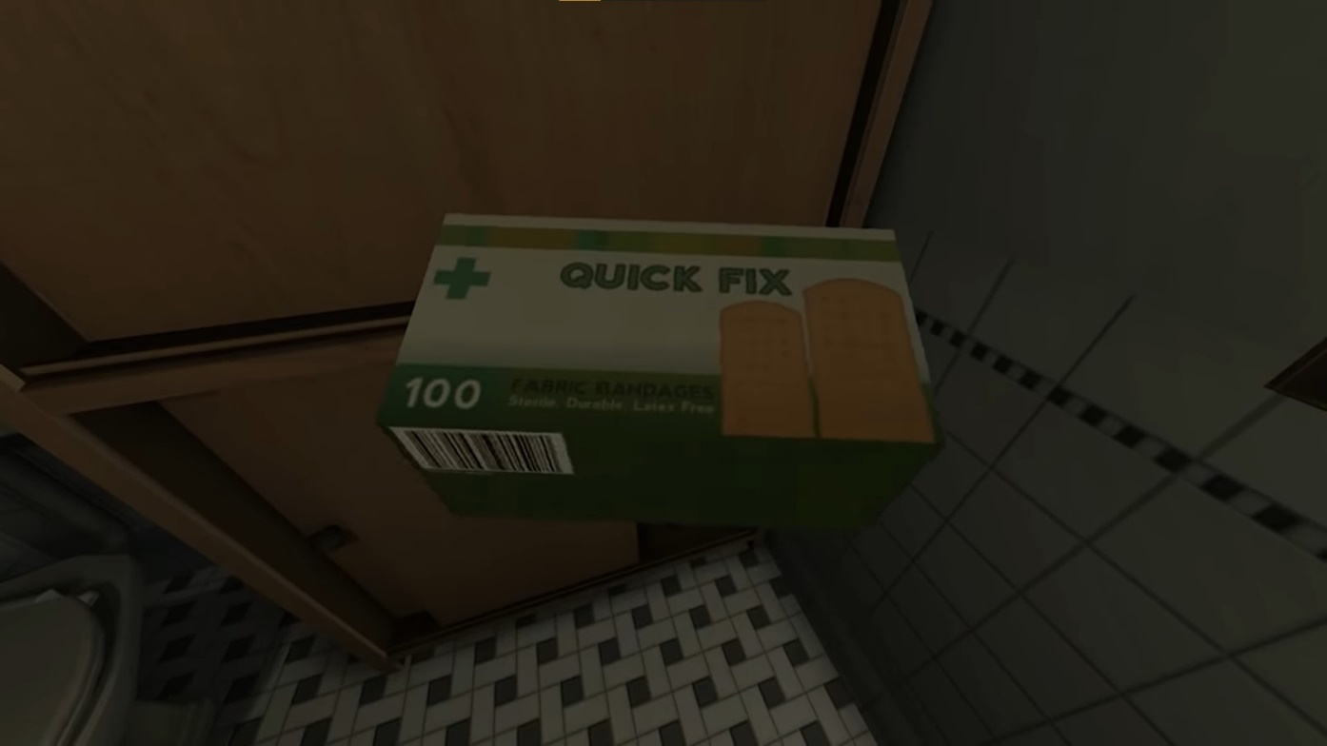
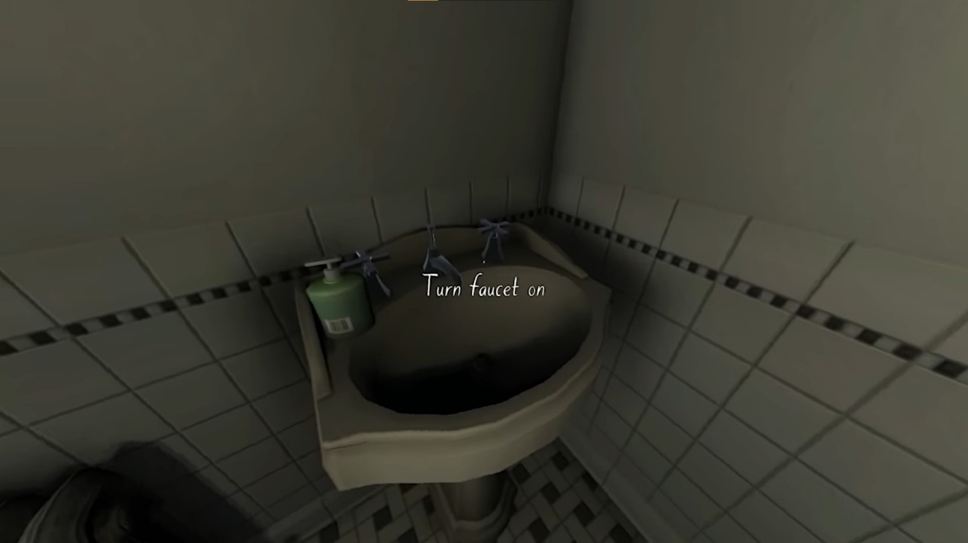
GH: Overview - Mechanics
The controls of GH are exceedingly simple, and consist of basic movement, interacting with environment objects such as light switches and doors, and inspecting smaller objects. Part of the charm of GH is the sheer number of interactable objects. The player can turn on and off faucets in the bathroom, pick up a box of bandages from a cupboard and read the labels (Top), listen to recordings on the phone’s answering machine, and read numerous notes, letters, and journal entries.
UI is extremely minimal. There is no HUD, other than interaction text prompts when the player is looking at an interactable object (Bottom). Occasionally there will be a hint, when the player discovers a piece of information or key that unlocks a new area. The menu itself is minimalistic, with a simple map showing where the player currently is and where they can go. A small inventory holds items such as the PC’s passport and a key. The simple mechanics serve to support and elevate the PX, allowing the focus to remain on exploration, environment, atmosphere, and narrative.

Slide 17
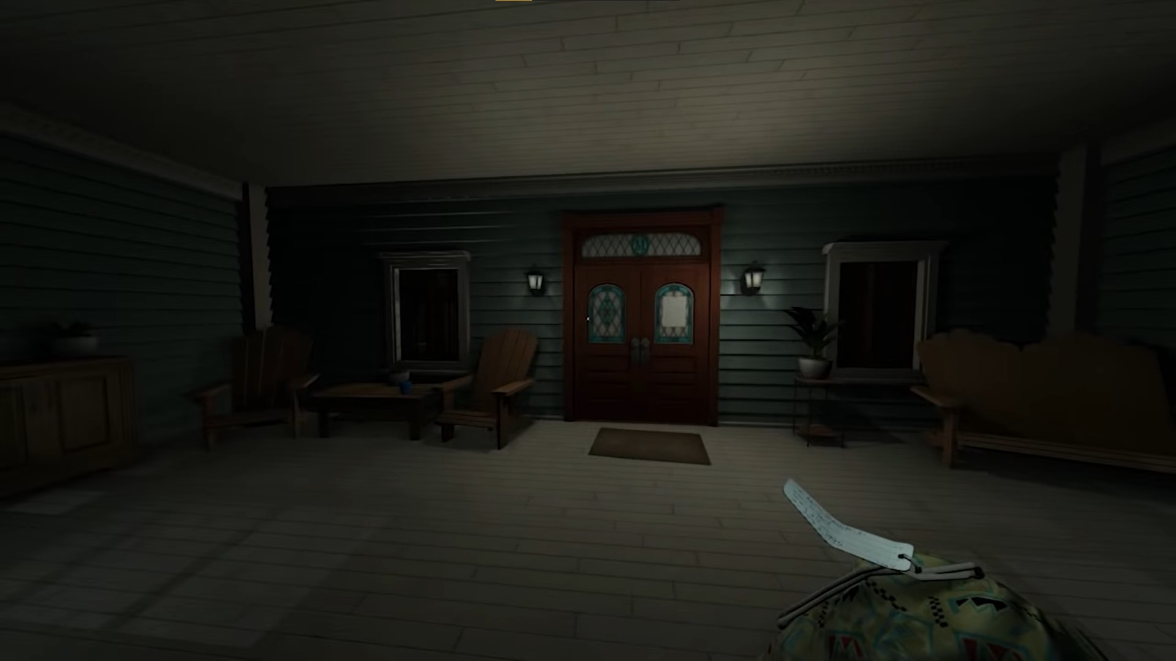
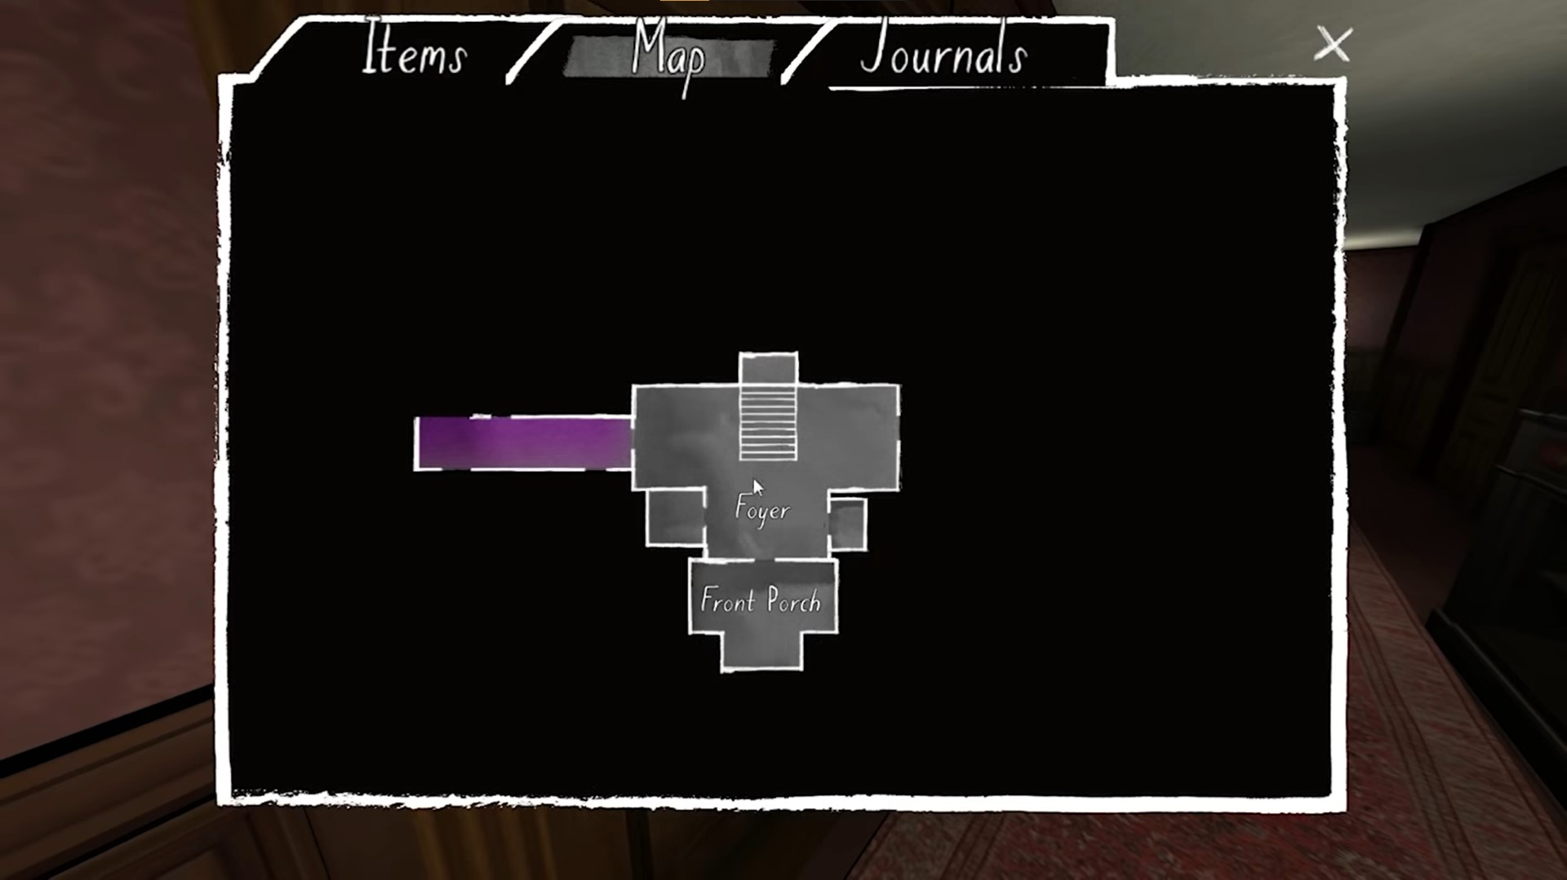
GH: Overview – Gameplay Experience and World
The entirety of GH takes place in the suburban Oregon home of the Greenbriar family. While the PC, Katie, was travelling abroad her family moved home. As such, she is as unfamiliar with the setting as the player. Upon arrival, it is the 7th of June 1995.
The map consists of a two-floor house (with an attic and basement), with interconnecting rooms, long hallways, and secret passages. The house is dark, as no one is home. It inspires a sense of loneliness, and while the game is not horror, it does create “a personal kind of horror that has resonated with a lot of players” (Carpenter, 2019). The environment, with its moody lighting, lack of any background music (although incidental music is played during important moments, such as reading notes), rainy atmospheric sounds, and quiet creaking of the floorboards under the player’s feet create a sense of unease, heightened by the narrative.
The choice to set the game in such a familiar environment was partially inspired by design limitations, as the team was extremely small and had made the decision to prioritise storytelling over high-fidelity visuals (Alexander, 2013; Korfhage, 2015). However, it is also a setting that most players would be familiar with, making it easier to form a connection with the PC.

Slide 18
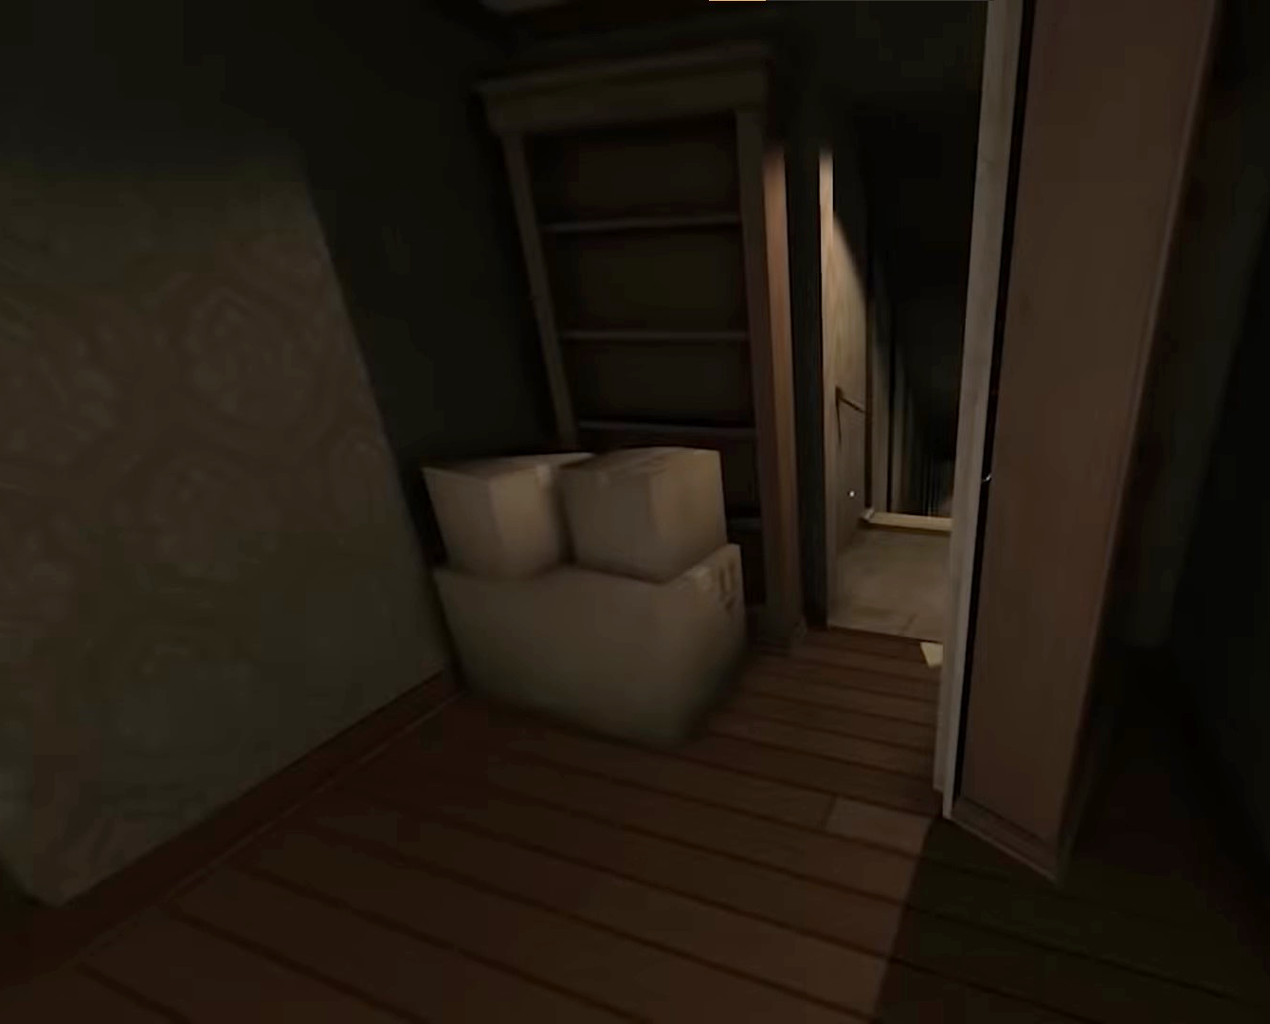
GH: Analysis – Visual and Audio Design
Across the wide genre of action-adventure games, and specifically in the “walking sim” genre, “creating a space to immerse and connect with the player has been important and exploration of that space has become a game mechanic in and of itself” (Goins, 2014). This is highly evident in GH, where exploration is the core theme and method of narrative delivery. However, to make exploration enjoyable, the environment the player is exploring must be interesting; an immersive world helps to elevate an explorative experience. GH achieves this through the use of excellent audio/visual design.
Much of the atmosphere of GH is created through incidental music, achieving “well-made ambience [that] blends perfectly with the game world, creating immersion” (Salo, 2021). There is no constant background music, instead the player is accompanied by the sound of rain and occasional thunder. The only extradiegetic sounds are those of UI and of incidental music during key narrative moments, such as when a new note or important piece of information is discovered (Pier, 2014). The fact that most of the audio is diegetic allows for a greater sense of immersion, which is essential in a game such as GH where the player must strongly identify with the PC.

Slide 19
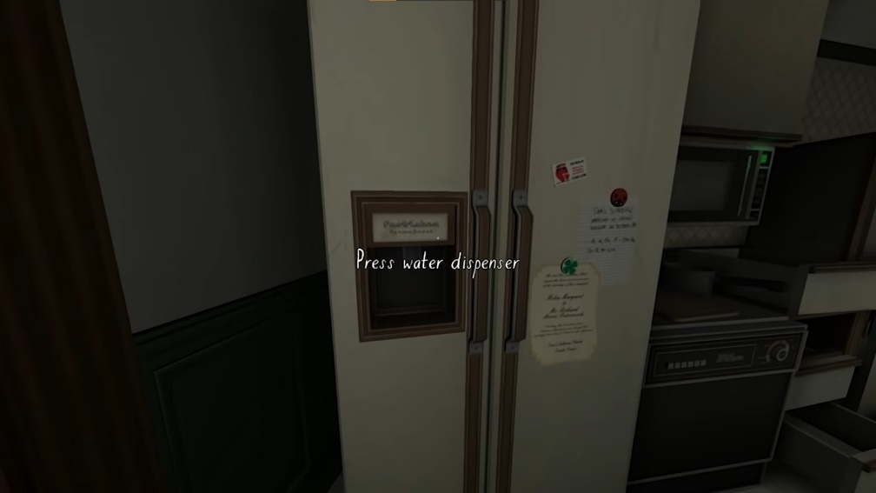
GH: Analysis – Visual and Audio Design
The game is set in a 1995 upper-class suburban family home. The family has only recently moved in, evidenced by the numerous partially unpacked boxes scattered throughout the area.
The environments are simple, but the ingenuity comes from the sheer number and variety of interactable objects (Goins, 2014). Katie, the PC, can pick up or interact with objects around the house, from taps in the bathroom sink to her father’s unsold books, going as far as being able to remove frozen produce from the family freezer and read the labels.
The environment is dimly lit, with the player able to switch on or off ceiling and floor lights. This low lighting, along with the sound of rain and the empty house, create a sense of isolation and a slightly spooky atmosphere (Goins, 2014).

Slide 20
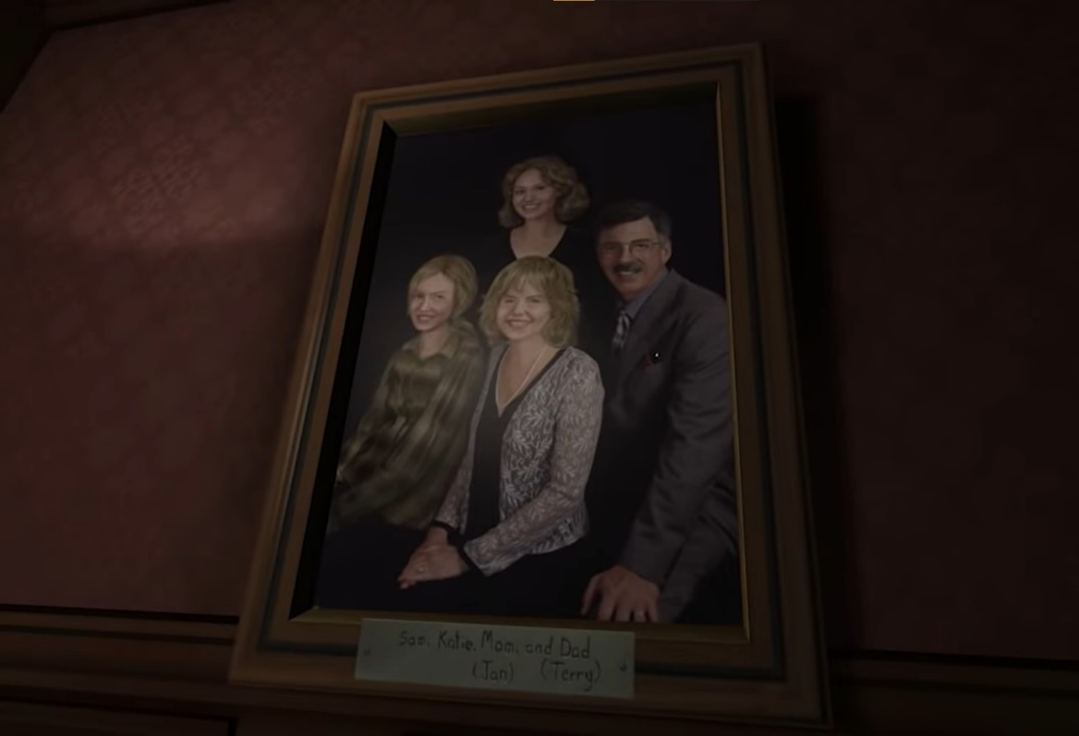
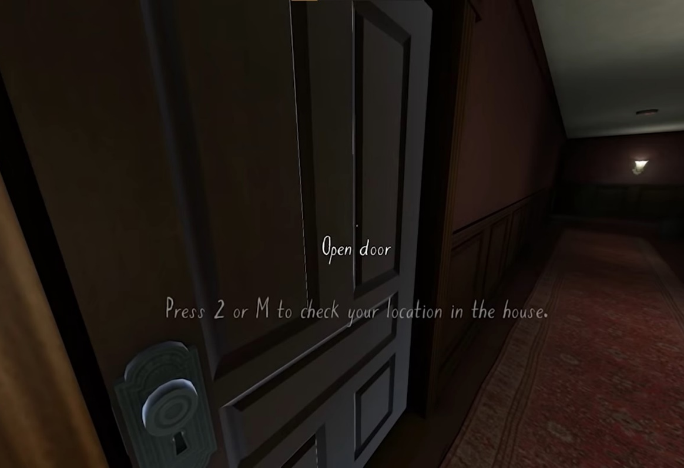
GH: Analysis – Representation, Identity, and Mediation
Much of the game is designed to create a strong emotional connection between the player and the PC and her family. Upon first loading in the game, the player is given the bare minimum context. From the starting area (front porch) the player can discover the PC’s name and age, the existence of Sam, and the general setting (suburban Oregon home, late at night).
In a design choice also seen in WRoEF, UI is minimalistic. However, GH’s menus have a less diegetic design than those of WRoEF, with map and inventory panels in a more traditional game UI. While there are some small HUD elements, such as text interaction prompts when the player is looking at an interactable object (Bottom), they are small and unobtrusive, and do not majorly detract from the overall experience.

Slide 21
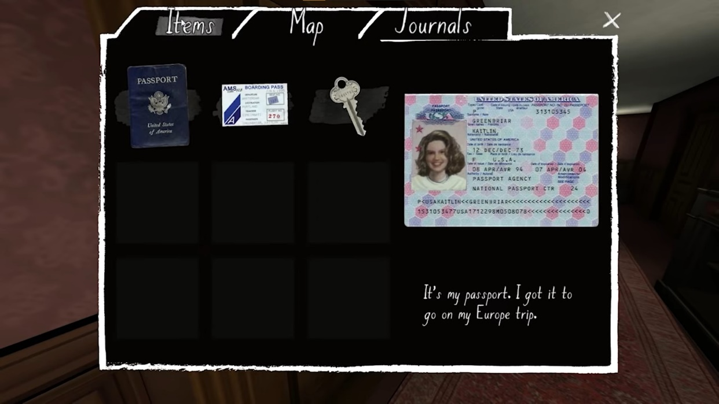
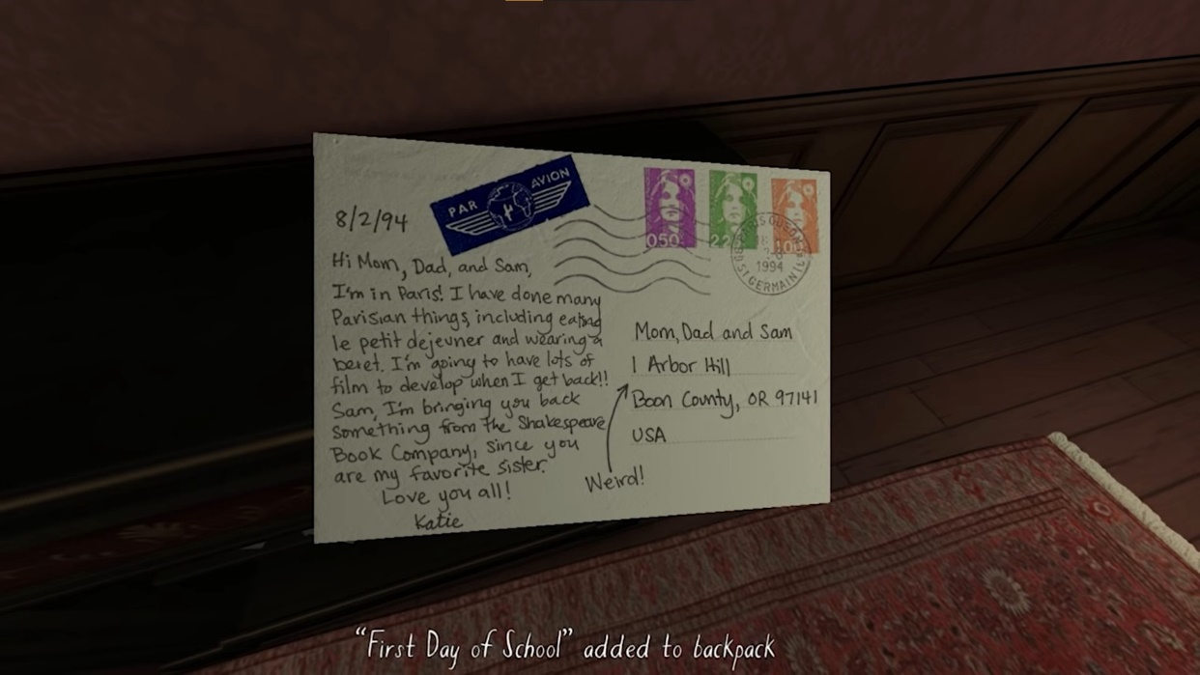
GH: Analysis – Representation, Identity, and Mediation
Katie is an example of a fixed character (Heussner et al., 2015, pg. 78-79). While she has a less well-defined personality, set of motivations, and place in the world when compared to Edith of WRoEF, Katie still has a preset backstory and connections to the characters and world. These are delivered to the player through multiple avenues, including journal entries, interactable objects hidden throughout the house, and other narrative elements.
Narrative or dramatic irony is the phenomenon where the knowledge that the player or viewer has differs from the knowledge of the character (The Editors of Encyclopaedia Britannica, 2019). This is a common tactic in numerous forms of fiction, especially prevalent in live theatre. However, in interactive fiction, it can create a dissonance between the player and PC. In GH, the player and PC can be assumed to have a remarkably similar level of knowledge; while Katie does know her family better than the player does, she has been away from home for an extended period.
Additionally, Katie has never been to this house before, so both her and the player discover the layout of the map in tandem. The events that led up to Sam leaving home are as much a mystery to Katie as they are to the player, meaning that there is little to no difference between the knowledge available to the PC and the player. This reduces the narrative dissonance, allowing the player to place themselves more easily in the shoes of Katie Greenbriar.

Slide 22
GH: Analysis – Representation, Identity, and Mediation
The issue of personal identity is core to the narrative experience. Much of the dramatic tension comes from following the story of Sam and Lonnie, and their burgeoning romance. In a key narrative moment, a spoken journal entry from Sam details a confrontation between her and her parents, where they assure her that it is a phase she will grow out of. She remarks it will be a “very long phase.” In another note, this time from her father Terrance, the player learns that the Greenbriar parents forbid Sam and Lonnie to be in Sam’s room with the door closed and are actively trying to dissuade Sam from perusing Lonnie romantically. While not overtly homophobic, the reaction of Sam and Katie’s parents does reflect the response of many parents when confronted with the identities of their queer children.
Upon release, the inclusion of this queer-centric storyline was controversial (Korfhage, 2015). The publication Polygon gave GH a rare 10/10 rating, sparking accusations of bribery or a “gay agenda.” This controversy was short-lived, with the longer-lasting debate surrounding the “gameness” of so-called walking sims (Sinclair, 2014).

Slide 23
GH: Summary
Takeaway | Description
Narrative Structure | “Hourglass” Shaped Golden Path
Narrative Themes | Identity, Family, Relationships
Visuals | Lower fidelity, atmospheric
Player Character (PC) | Pre-defined
Average Playtime | 2-3 hours
Intractability | Relatively high amount of interactable objects
Inventory | Small inventory
GH creates a striking PX through the use of environmental storytelling, atmospheric audiovisual design, and a non-linear narrative based around a central exploration mechanic. While Edith Finch is a rigidly fixed character, Katie Greenbriar falls closer to the definition of a cipher, while still within the bounds of a fixed character type (Heussner et al., 2015, pg. 78-79).
I will discuss what elements of the On the Origins of Conjurations prototype were informed by GH in a dedicated section after the analyses.

Slide 24
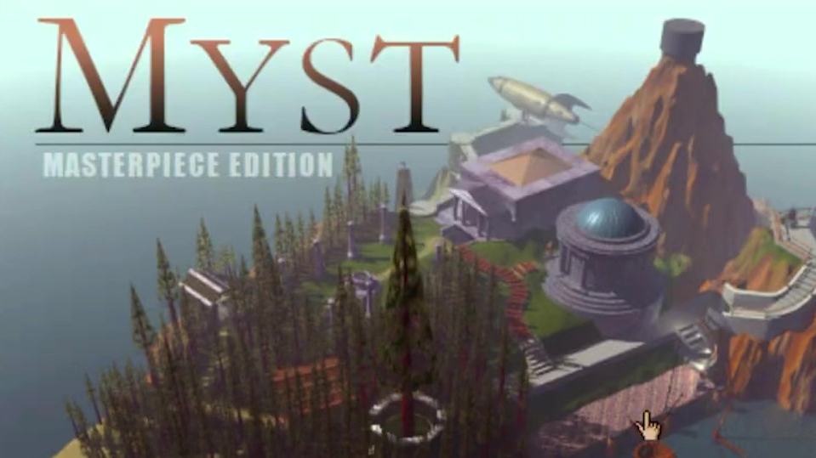
Myst: Masterpiece Edition
Context
Myst, originally released in 1993 by Cyan games, is an adventure puzzle game created for the Macintosh. It is also recognised as an example of “games as art” (Rothstein, 1994), and is seen as a classic, genre defining game. The specific version of this game played for this project is Myst: Masterpiece Edition, originally published in 1993 and updated in 2000 for more modern systems (Cyan Games, n.d.). Myst has been rereleased multiple times since. realMyst: Masterpiece Edition, released in 2014, “moved Myst from point-and-click to a fully navigable graphical experience” (Cyan Games, n.d.). In addition, there were multiple and numerous clones (Cyan Games, n.d.) (Parrish, 2011).

Slide 25
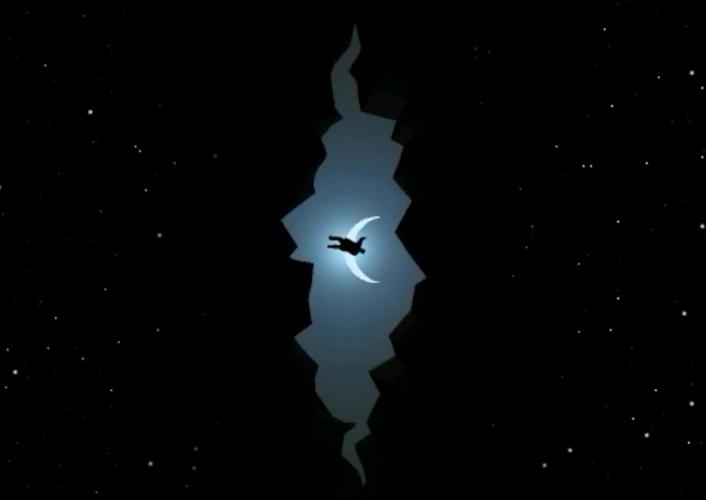
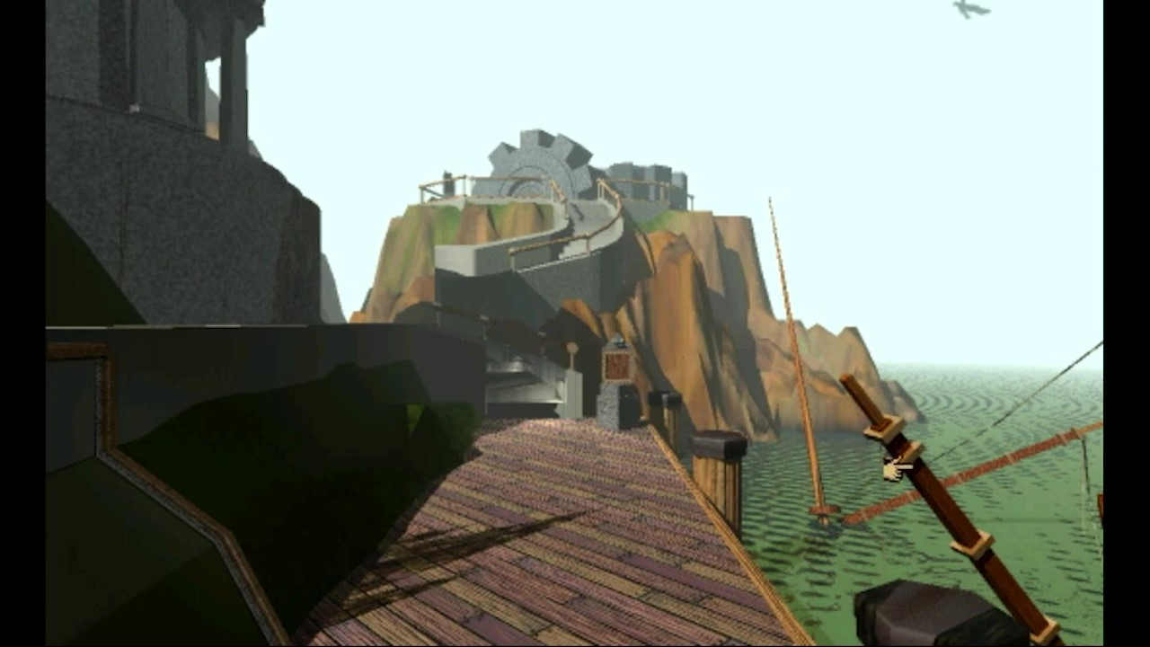
Myst: Masterpiece Edition: Overview - Narrative
Upon first entering the game, little information is given to the player. The game begins with a short cutscene, in which a voice narrates over a book falling through space (Top). The book is inferred to be a “Myst book,” and the voice states that it hopes whoever finds the book will make effective use of it. It is implied that the PC picks up this book, and on the last page sees a picture of an island. Clicking on this picture transports the player to the island.
Gameplay then begins, with the player on a wooden pier (Bottom). To their right, a half-sunken sail ship and beyond that an endless ocean; to their left and to the front, strange buildings. The player then explores this island, encountering several puzzles. The story is pieced together from a series of journals and environmental clues; in a large building the player can find a shelf full of burned books. A few of these books seem to have survived, and the player can read these to learn about an unnamed person, his sons Sirrus and Achenar, and his wife Catherine. A note along a path, addressed to Catherine from “Atrus,” can also be found.

Slide 26
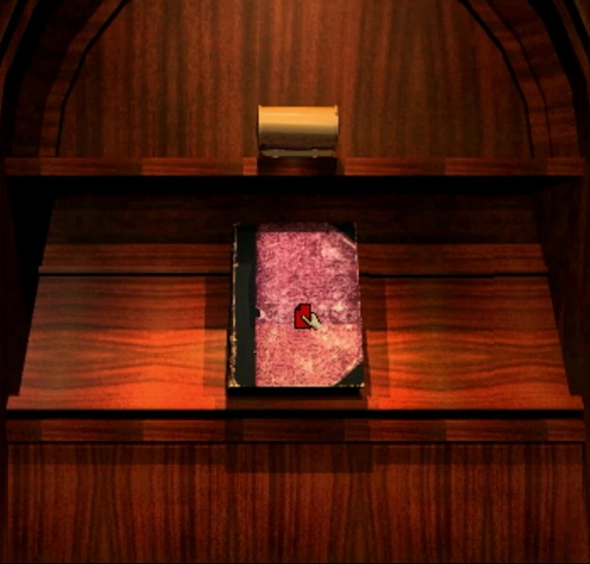
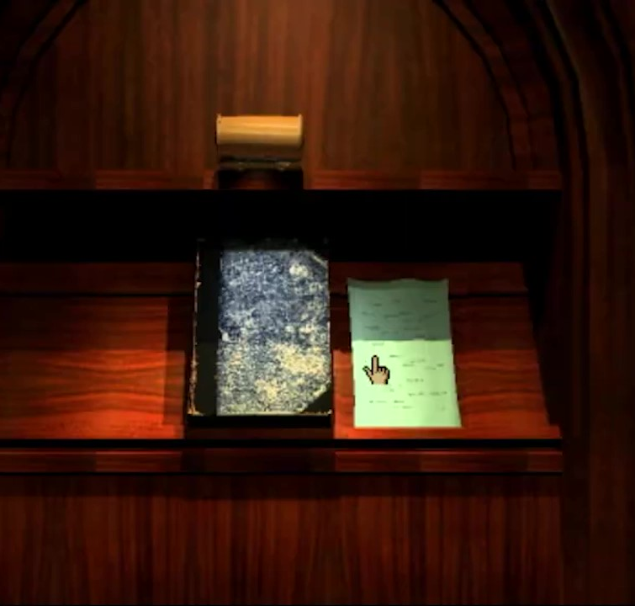
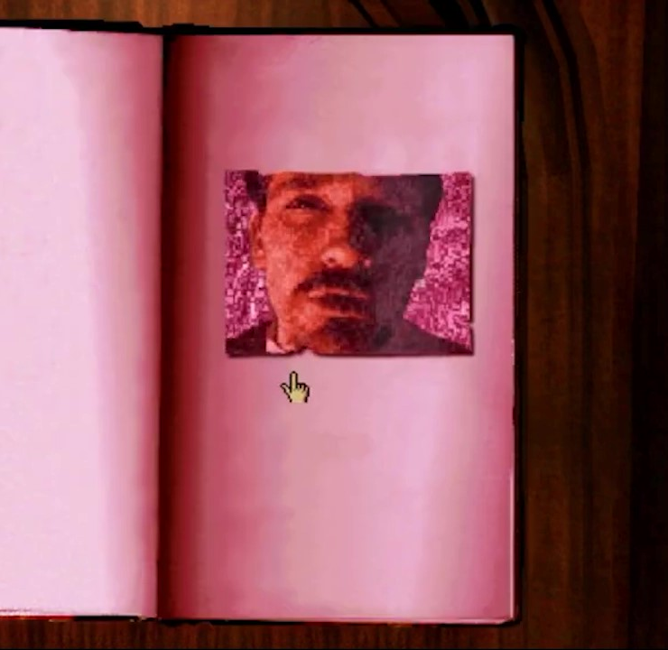
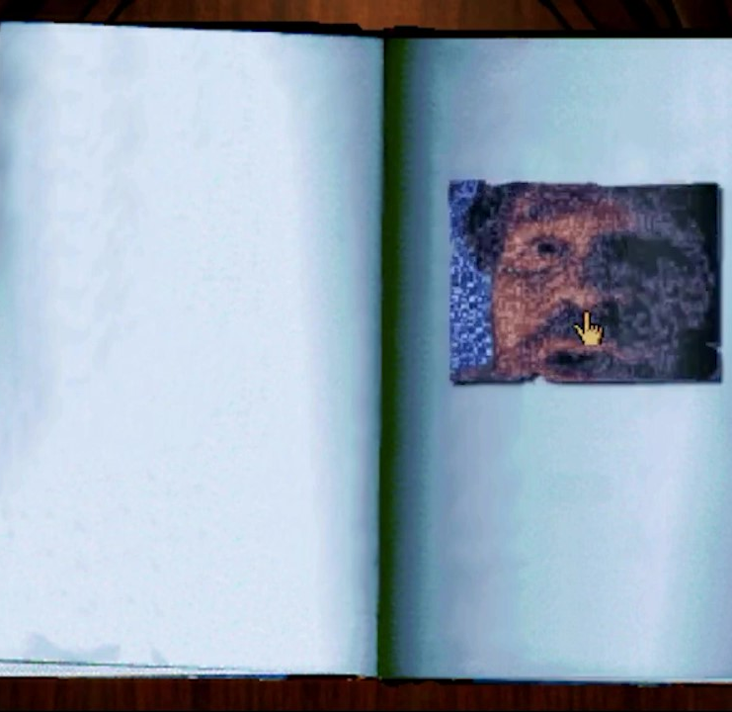
Myst: Masterpiece Edition: Overview - Narrative
Through reading these books, the player can learn that Atrus possesses books called “Ages,” which can be used to travel to other worlds. However, he has gone missing. Much of the narrative is delivered by Sirrus and Achenar, who are both trapped in special “Prison” Books (Top).
Throughout the different worlds the player can visit, red and blue pages can be found. These pages can be placed in Sirrus of Achenar’s books respectively, allowing them to speak to the player. They both inform the player that the other brother is to blame for the death of their father and the destruction of his library (Bottom).
There are four per book to be collected, one in each Age. Once the fourth page of either book is found, the respective brother will inform the player of the location of the final page. However, there is also a green book there that the brothers will urge the player to ignore.
This is where the narrative diverges into one of three endings. If the player returns to the main island (Myst) with the last red or blue page and completes either the book of Sirrus or Achenar, freeing that brother, the player will take their place in the prison book.
The third (and canonical) ending takes place if the player uses the green book to enter its Age, where they find Atrus imprisoned. There is a green page hidden on Myst island, and if the player enters the green book’s Age (D’ni, where Atrus and the Art of writing Ages originate) without this page, they are trapped there with Atrus. However, if they bring the page to Atrus, they will return to Myst together. Atrus will thank the player and allow them to roam the Ages freely. If the player returns to where the prison books were located, they will find only scorch marks.

Slide 27
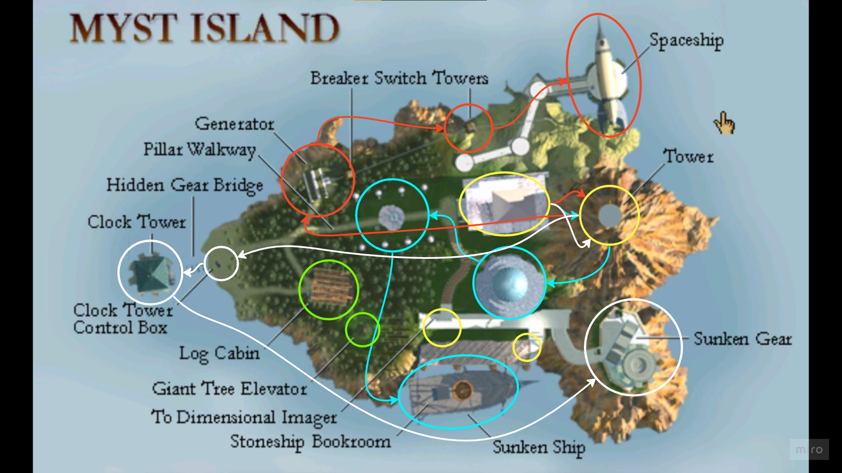
Myst: Masterpiece Edition: Overview - Mechanics
In Myst: Masterpiece Edition, like the original, the player does not move freely as in other, more modern “walking sims.” Rather, the player clicks on the screen in the direction they wish to go. This was updated for the 2014 remake, realMyst: Masterpiece Edition, to include more familiar movement (Cyan Games, n.d.).
Myst is, at its core, a puzzle and logic game. For example, the “hub” world of Myst contains the linking books to five other ages (including D’ni). Each of these books is locked behind a puzzle. To access each of the various “Ages,” a series of puzzles must first be completed, most containing three steps.

Slide 28
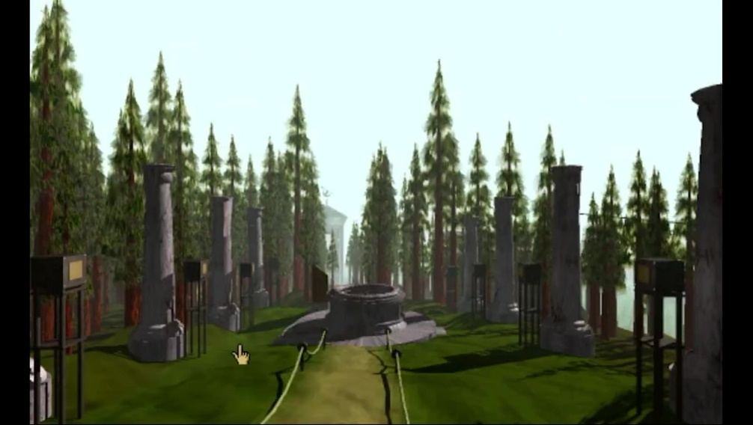
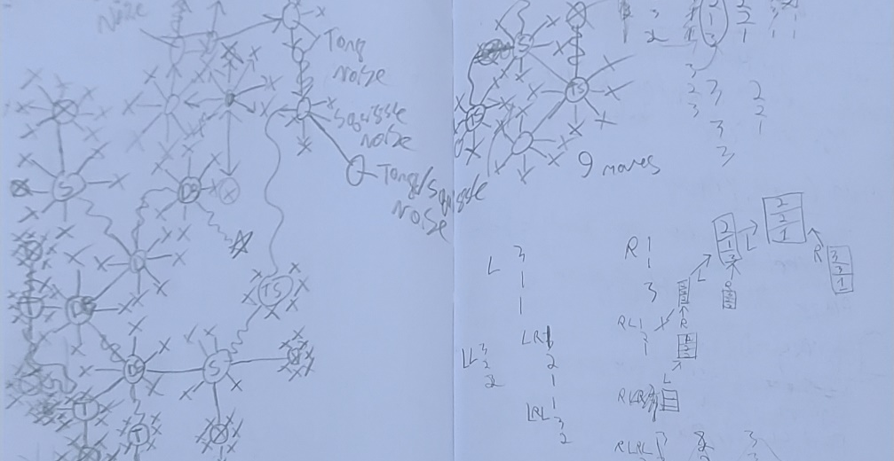
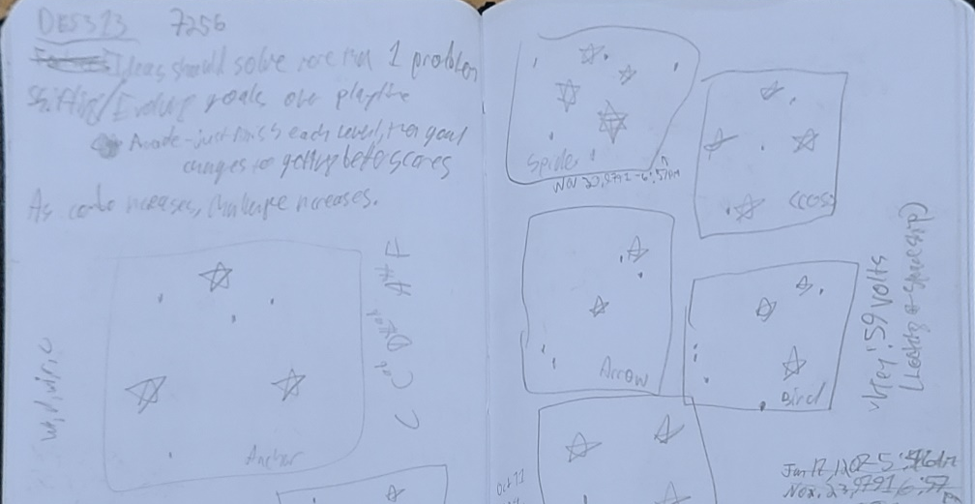
Myst: Masterpiece Edition: Overview - Mechanics
Much of the game is structured in this way, with each puzzle relying on the player discovering information in a different location. Often the player sees the goal long before they see the starting point. For example, the player starts off directly next to a half-sunken sailing ship. This ship contains a linking book, but there is no obvious way to immediately get there. It is not until the player has explored the island that they will find what appears to be the starting point, a fountain with a model of the ship in the middle (Top).
To allay backtracking, utilising a notebook should be recommended (Middle, Bottom).

Slide 29
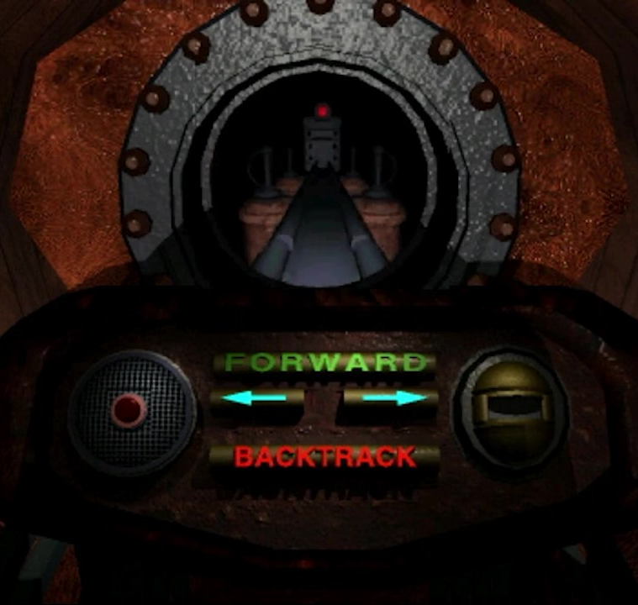
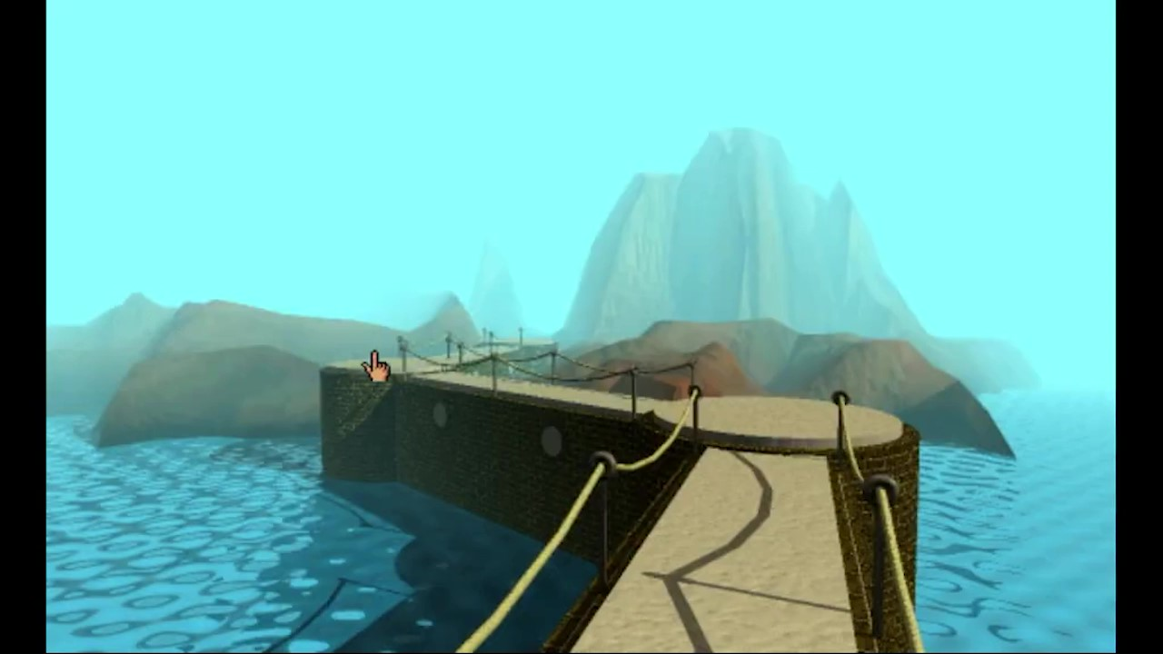
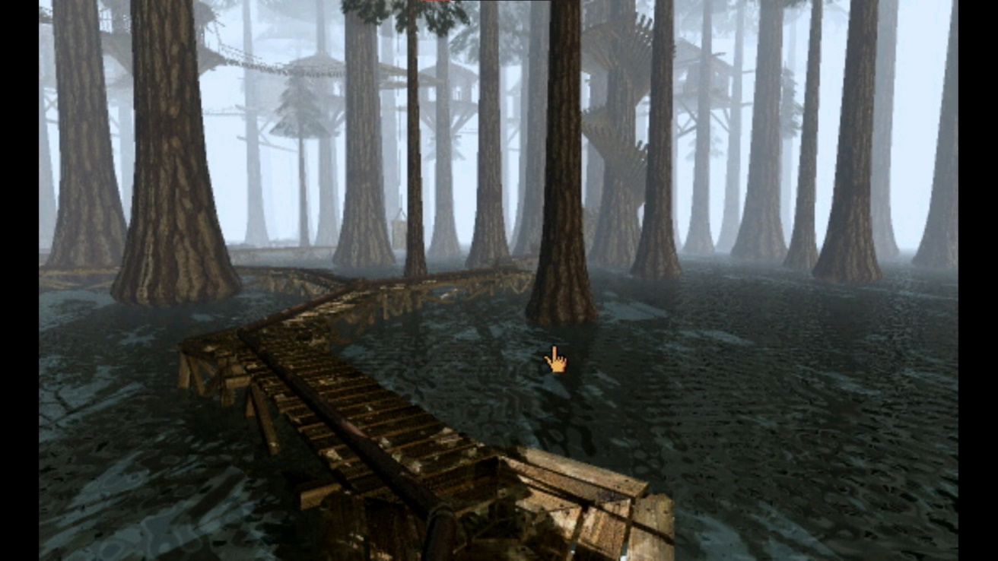
Myst: Masterpiece Edition: Overview - Gameplay Experience and World
Each of the various Ages/levels the player visits are highly unique. The hub world, Myst, consists of a small island in an endless ocean. There is no background music, only the sounds of wind and water. The Selentic Age also seems to be an island in a vast ocean, but while Myst is wooded and green, the Selentic Age is desolate and sandy, with only one small area of greenery (Top Right).
The player has a limited amount of agency within the world. There are few paths to follow, and the movement mechanic of clicking in the direction the player wishes to travel does not lend itself to a freeform experience. However, Myst does an excellent job of making the player feel smart for solving a puzzle. Myst is a challenging game, and any progress feels like a great achievement both due to the game’s challenge and extensive use of auditory and visual feedback.

Slide 30
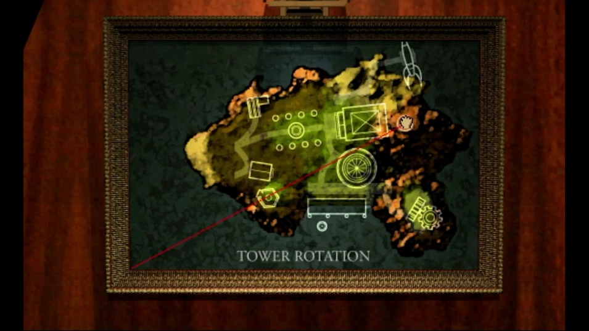
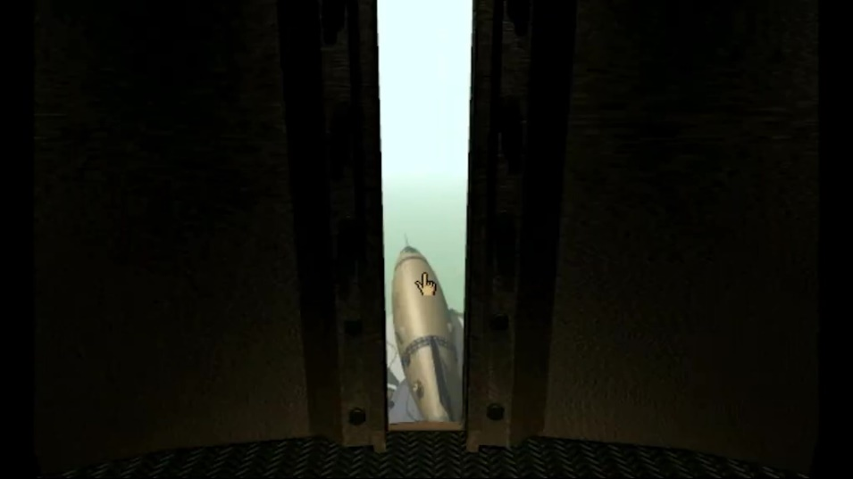
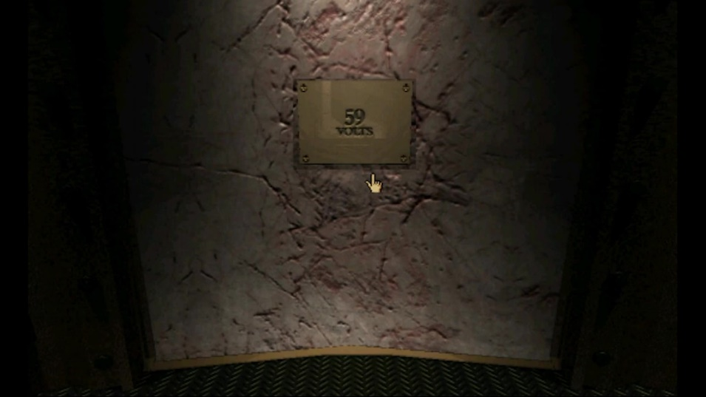
Myst: Masterpiece Edition: Analysis – Abstraction and Rules
Abstraction is defined as “the level of detail in which the ﬁctional world has been implemented, and how much nuance of interaction is provided to the player” (Fernández-Vara, 2019, p. 146). In this context, abstraction can be understood to be the level of realism of the game’s rules.
Much of the puzzle elements in Myst rely on having an interaction in one location, and understanding what it affects somewhere else. For example, on the titular starting island of Myst, there is a tower that can be rotated using a painting in the library (Top).
By rotating the tower, various locations around the island are targeted through its window (Middle), and on the opposite wall a different clue is revealed (Bottom).
The player must infer that those clues somehow apply to the related location, and if they forgot a clue (or neglected to write it down), they must return to the library, rotate the tower to the right spot, climb up to the tower, and check the clue again.

Slide 31
Myst: Masterpiece Edition: Analysis – Abstraction and Rules
Myst has no inventory system. The player will not pick up keys or crank handles, but rather will gather information. Like many other walking sims, however, there is a fair deal of backtracking involved. In one of the Ages, the “Selentic Age” found by powering up a spaceship, the player passes a locked door with no obvious way to open it.
It is only after the player has explored the rest of the small sandy island and completed the sound-based puzzles scattered around it that they gather the clues needed to open this locked door.

Slide 32
Myst: Masterpiece Edition: Analysis – Abstraction and Rules
As well as info-gathering and backtracking, Myst relies on its simple movement and mechanic systems to create its PX.
“Myst did not have still images because Cyan’s designers were limited in their vision and ambition…” but rather because “there were no computers in general use that were capable of doing… large amounts of calculations [required for more realistic visuals] in a practical amount of time” (Hutchison, 2008).
Later Myst sequels and remakes, such as 2014’s realMyst: Masterpiece Edition and 2020’s Myst VR showcase that the game works perfectly well with modern, high-definition graphics.
Images:
Left Top: Myst, 1993
Left Bottom: Myst: Masterpiece Edition, 1999
Right Top: realMyst, 2002
Right Middle: realMyst: Masterpiece Edition, 2014
Right Bottom: Myst (VR), 2020

Slide 33
Myst: Masterpiece Edition: Analysis – Abstraction and Rules
However, the technical limitations of the time bred creativity in the design of Myst. The simplistic movement characteristic of Myst makes every view seem more important. Why would the game allow you to look in a certain direction unless there was something important there to see? This lends itself to slower, more thoughtful playthroughs, which works well with the information-gathering backtracking mentioned earlier.
Simplicity is not only present in mechanics, but also in puzzle design. Many of the puzzles consist of simple codes, such as a puzzle wherein the player must enter a code only by turning two levers, each controlling two rings (Top).
While Myst can be extremely challenging, it manages to balance challenge with player competency by ensuring many of its puzzles are short. This allows the player’s competency to never exceed the challenge by too great a margin, thus creating boredom. Myst ensures the opposite does not occur by giving the player numerous puzzles to work on at once; if the player feels that the challenge exceeds their ability, they are able to switch their focus to a different puzzle and come back to it when they feel ready. Often, the game teaches the player techniques or puzzle elements that will help them in other sections, for example a control-the-flow type puzzle represented in both the hub (Middle) and one of the Ages (Bottom).

Slide 34
Myst: Masterpiece Edition: Analysis – Representation and Mediation
The PC of Myst, referred to as “The Stranger,” is a textbook example of a blank slate or cipher character type (Heussner et al., 2015, pg. 78). The PC never speaks and is never seen, is never referred to by name, has no backstory, and no built-in motives or character. The player can project themselves onto this blank slate, creating any persona they wish. This reflects on the PX of Myst: the focus is not on the PC, but on the environment, the puzzles, and the narrative. Compare this to the previously discussed WRoEF and GH, which both have fixed PCs, and whose narratives focus more heavily on the PC and their places within the world or narrative.
Myst, as a puzzle game, must balance the line of challenge and enjoyment carefully. The perfect balance between these has been described as flow, which is defined as “holistic sensation present when we act with total involvement” (Csikszentmihalyi, 2014, pg. 136). More specifically, flow is discussed as the state where competency and challenge are balanced so that enjoyment and involvement are maximised, or “the state in which action follows upon action according to an internal logic which seems to need no conscious intervention on our part” (Csikszentmihalyi, 2014, pg. 136-137).
Myst is, according to fans and critics, a difficult game (Fournier, 2002). If challenge exceeds player competency, the player becomes discouraged. Csikszentmihalyi describes this as the “worry” zone. However, if player competency far outstrips challenge, the player becomes frustrated and bored (Right) (Csikszentmihalyi, 2014, pg. 146-147).

Slide 35
Myst: Masterpiece Edition: Summary
Takeaway | Description
Narrative Structure | “Hourglass” Shaped Golden Path
Narrative | Environmental Narrative
Visuals | Limited by tech, atmospheric
Player Character (PC) | Cypher
Average Playtime | 5-6 hours
Intractability | Somewhat high amount of interactable objects
Inventory | No inventory
One of the games that helped the walking sim genre, ”Myst may be the first widely experienced computer mediated, audio-visually rich virtual reality experience” (Hutchison, 2008). Myst achieves its PX through immersive environments, nonlinear storytelling, information-gathering, backtracking, and complex narrative puzzles.
Myst, like WRoEF and GH, provides a sense of immersion and atmosphere through environmental storytelling, audio, and visual design. It also creates a sense of flow through the careful balance of difficulty and player competency, teaching the player certain puzzle solving skills that are utilised in multiple places. Its non-linear yet chapter-based narrative is an interesting middle ground between the linear chapter-based story of WRoEF and the far more free-form GH.
The use of a blank slate PC (Heussner et al., 2015, pg. 78-79) allows the focus to remain on the narrative, environment, and puzzles.
I will discuss what elements of the On the Origins of Conjurations prototype were informed by Myst in a dedicated section after the analyses.

Slide 36
Takeaways
In this section, I will discuss the key elements that went into creating the PX of each of the previously discussed games, which elements are unique to or shared between each game, and which went on to inform the design of On the Origins of Conjurations (OOC).
Based on the findings of the three games discussed, and from research on other games in similar genres, the key elements that will be used to inform the design of the PX of OOC are Audiovisual Design, Representation and Mediation, and Motivations.
This table (and the adjoining Venn Diagram) show some of the high-level design choices that helped to support the PX designs of the three reference games, and what design choices were made for OOC based on these references.
Element | WRoEF | GH | Myst | OOC
Inventory | No Inventory | Inventory | No Inventory | No inventory
Narrative Structure | Chapter Based | Free | Chapter Based | Free (Semi Chapter Based)
Narrative Path | Linear | Nonlinear | Nonlinear | Nonlinear
PC | Predefined | Predefined | Cypher | Cypher
Visuals | High-fidelity | Low-fidelity | Low-fidelity | Low-fidelity
Endings | One | One | Four | Three
Filler | Low Content | High Content | High Content | High Content
Context | Some | Some | None | Nearly None
Audio | Atmospheric | Atmospheric | Atmospheric | Atmospheric
Mechanics | Exploration, Puzzle | Exploration, Puzzle | Puzzle, Exploration | Exploration, Puzzle

Slide 37
Takeaways – Audiovisual Design
Element | WRoEF | GH | Myst
Background Music | Used often – consider the levels of Lewis and Gregory | Occasionally – upon interacting with a key item such as a note | None
Background Audio | Atmospheric – each area makes use of audio design to firmly place the player in a location (seaside, cannery, creaky old house, etc.) | Atmospheric – the soft sounds of rain and thunder, along with the quiet sounds of the Player’s footsteps and interactions creates a familiar environment. | Atmospheric – the simple sounds of waves and wind follow the Player nearly everywhere. The quiet environments are periodically broken up by sound effects (ticking of a mechanism, dripping water, etc.)
Art Style | Highly saturated, realistic but not photorealistic. Cozy. Makes strong use of lighting to evoke emotions. | Simple, but with a more realistic colour scheming. | Minimalist – partly due to technical limitations of the time.
Environment Design | Cozy and cluttered, with a high quantity of narrative storytelling. | High level of narrative storytelling, with more open environments. Still busy, but more spread out. | Minimalist and efficient – environments tell a story with a small amount of assets.
All three games previously discussed use audio and visual design to support their PXs. In the case of WRoEF, the use of lighting and incidental music is key. For GH, it is the atmospheric audio and simple visual style that stand out, while in Myst, the simplicity of the visuals coupled with sparse environmental sounds create bleak and immersive areas to explore.
Based on the design choices of these games, and the technical limitations surrounding this project, I have decided to utilise a minimalist style, with simple art and audio assets.
While audiovisual elements are key to the PX of the reference games, it is evident from the success of Myst that a highly detailed or technically high-quality visual style is not essential to creating a PX similar to that which OOC plans to achieve.

Slide 38
Takeaways – Representation, Identity, and Mediation
Looking at the PCs of WRoEF, GH, and Myst, we can place them on a continuum from cypher to predetermined (Heussner et al., 2015, pg. 78-79). While this is slightly reductive, ignoring other PC types such as avatars, this diagram works for our purposes to showcase the level of context and narrative background given to the player about their PC.
As discussed earlier, “The Stranger” of Myst is an example of a Cypher, while the PCs of both GH and WRoEF are classified as predefined characters, based on the level of context, background, and personality provided to the player, as well as the amount of focus given to the PC through the narrative. The PC of OOC is given a title, rather than a name (Myst), but is given a specific role within the world of the game (GH, WRoEF). The PC is known as “The Apprentice.” They have no predefined backstory (Myst), but a written motivation in the form of a letter given at the start of the game (GH, WRoEF).
The PC will not be explored or developed through the narrative. The focus of the story is on the Mage, similarly to how the narrative of Myst is centred around Atrius and his family, rather than on the Stranger. The PC’s core motivation is to complete the puzzles and escape the house. However, this contrasts with the Player’s motivations.

Slide 39
Takeaways – Player Motivations
All the three previously discussed games use a mixture of distinct types of motivators. Motivators can broadly be defined as intrinsic and extrinsic. Extrinsic, or environmental-shaped motivation, comes from outside of the individual. They are taught and reinforced, through various means (Hodent, 2017, pg. 61). Intrinsic motivation is within the individual and comes from enjoyment of the task itself (Hodent, 2017, pg. 65).
Extrinsic motivation is created through learning and reinforcement. The player is taught that certain actions have certain outcomes, and this is reinforced through repetition. By the definition of the psychologist B.F. Skinner, reinforcement comes in four types: positive rewards (adding a reward), negative rewards (removing a punishment), positive punishments (adding a punishment), and negative punishments (removing a reward) (McLeod, 2023).
Regarding extrinsic motivators, WRoEF utilises primarily positive rewards, such as with the completion of Edith’s family tree. It can be argued that the delivery of information and unravelling of mystery could be included under the labels of positive reward and negative reward, respectively.
GH, meanwhile, heavily leans into the discovery of narrative beats, which would fall under positive reward, with the reward being information and understanding. As a secondary reward, there are several optional journal entries throughout the game which can be collected.
Myst rewards the player through completion. The rewards given to the player include the completion of puzzles to unlock Ages, and the red and blue pages that can be collected therein.
For both WRoEF and GH, and later remakes of Myst, Steam or console achievements provide another extrinsic reward.
Extrinsic Motivators | Positive | Negative
Reward | Positive Reward: Given something positive | Negative Reward: Removed something bad
Punishment | Positive Punishment: Given something bad | Negative Punishment: Removed something good

Slide 40
Takeaways – Player Motivations: Intrinsic Motivation
Based on the Self-Determination Theory (SDT), intrinsic motivation can be broken down into three categories: Competence, Autonomy, and Relatedness. (Ryan and Deci, 2000)
Need for Competence: A desire for mastery, progression, and control over our environments.
Need for Autonomy: A desire for “meaningful choice, self-expression, and free will.”
Need for Relatedness: A desire to feel affiliated or connected with, or understood by, others.
(Hodent, 2017, pg. 66)
With these definitions in mind, there is a level of competence to the intrinsic motivations of all three games, with an especially strong emphasis prevalent in Myst. In WRoEF, the need for competence is seen in the completion of each level, reinforced by the extrinsic reward of seeing the family tree being filled out.
In GH, the need for competence is fulfilled in the unlocking of various rooms in the house, discovery of secrets and lore, and the gathering of information. And in Myst, the need for competence is highlighted through the completion of difficult puzzles.
Autonomy is evident, if to a lesser extent. In Myst and GH, objectives can be completed in whatever order the player wishes. Ages in Myst and rooms in GH can be unlocked and explored in any order. However, there is only one solution to each puzzle in Myst, and only one golden path in WRoEF, which has a more linear narrative.
The need for relatedness may play a role narratively, with the player seeking to relate to, understand, and connect with characters in the various games, although this need is usually more applicable to multiplayer or social games.

Slide 41
References
Alexander, L. (2013). How Gone Home’s design constraints lead to a powerful story. [online] Game Developer. Available at: https://www.gamedeveloper.com/design/how-i-gone-home-i-s-design-constraints-lead-to-a-powerful-story [Accessed 30 Oct. 2023].
Carpenter, N. (2019). Why Gone Home is the most important game of the decade. [online] Polygon. Available at: https://www.polygon.com/2019/11/13/20963006/gone-home-most-important-game-of-the-decade [Accessed 1 Nov. 2023].
Csikszentmihalyi, M. (2014). Flow and the Foundations of Positive Psychology: The Collected Works of Mihaly Csikszentmihalyi. 1st ed. Springer Dordrecht.
Cyan Games (n.d.). Myst | Cyan. [online] cyan.com. Available at: https://cyan.com/games/myst/ [Accessed 2 Nov. 2023].
Cyan Games (n.d.). Myst Online: Uru Live - Home. [online] mystonline.com. Available at: https://mystonline.com/en/ [Accessed 2 Nov. 2023].
Fabricatore, C. (2007). Gameplay and Game Mechanics Design: a Key to Quality in Videogames. [online] OECD. Available at: https://www.oecd.org/education/ceri/39414829.pdf [Accessed 30 Oct. 2023].
Fernández-Vara, C. (2019). Introduction to Game Analysis. 2nd ed. [online] Taylor & Francis Group. Available at: https://ebookcentral.proquest.com/lib/abertay/detail.action?docID=5646038 [Accessed 26 Oct. 2023].
Fournier, H. (2002). Myst Review - AdventureGamers.com. [online] AdventureGamers.com. Available at: https://web.archive.org/web/20141213023453/http://www.adventuregamers.com/articles/view/17473 [Accessed 18 Nov. 2023]. Archived from the original, 13 Dec. 2014.
Fullbright Games (n.d.). Gone Home: A Story Exploration Video Game. [online] gonehome.com. Available at: https://gonehome.com/ [Accessed 28 Oct. 2023].
Giant Sparrow (2019). Edith Finch. [online] Edith Finch. Available at: http://edithfinch.com [Accessed 24 Oct. 2023].
Giant Sparrow (n.d.). The Unfinished Swan. [online] www.giantsparrow.com. Available at: https://www.giantsparrow.com/games/swan/ [Accessed 26 Oct. 2023].
Goins, E. (2014). Gone Home and Its Hidden Objects. [online] Lost Worlds: Explorations in Game Design. Available at: http://explorelostworlds.blogspot.com/2014/02/gone-home-and-its-hidden-objects.html [Accessed 1 Nov. 2023]. Blog of Elizabeth Goins, Associate Professor, Rochester Institute of Technology.
Harkin, S. (2021). Liminal Rhetoric in Girlhood Games: Developmental Disruption in Night School Studio’s Oxenfree. Game Studies, [online] 21(3). Available at: https://gamestudies.org/2103/articles/harkin [Accessed 29 Oct. 2023].
Heussner, T., Finley, T.K., Hepler, J.B. and Lemey, A. (2015). The Game Narrative Toolbox. [online] CRC Press LLC. Available at: https://ebookcentral.proquest.com/lib/abertay/detail.action?docID=3569284 [Accessed 16 Nov. 2023].
Hodent, C. (2017). The gamer’s Brain : How Neuroscience and UX Can Impact Video Game Design. 1st ed. [online] Boca Raton, Fl: Crc Press, Taylor & Francis Group. Available at: https://doi-org.libproxy.abertay.ac.uk/10.1201/9781315154725 [Accessed 19 Nov. 2023].

Slide 42
References
Hutchison, A. (2008). Making the Water Move: Techno-Historic Limits in the Game Aesthetics of Myst and Doom. Game Studies, [online] 8(1). Available at: https://gamestudies.org/0801/articles/hutch [Accessed 16 Nov. 2023].
IMDb (n.d.). Valerie Rose Lohman | Actress, Writer, Director. [online] IMDb. Available at: https://www.imdb.com/name/nm6594706/ [Accessed 29 Oct. 2023].
Korfhage, M. (2015). #GamerFate. [online] Willamette Week. Available at: https://www.wweek.com/portland/article-25207-gamerfate.html [Accessed 1 Nov. 2023].
Mahardy, M. (2013). Meet me in Portland: The Fullbright Company’s journey home. [online] Polygon. Available at: https://www.polygon.com/features/2013/8/13/4568900/the-fullbright-company-gone-home [Accessed 30 Oct. 2023].
McLeod, S. (2023). What is operant conditioning and how does it work? [online] Simply Psychology. Available at: https://www.simplypsychology.org/operant-conditioning.html [Accessed 19 Nov. 2023].
Metacritic (n.d.). Gone Home. [online] www.metacritic.com. Available at: https://www.metacritic.com/game/gone-home/ [Accessed 30 Oct. 2023].
Metacritic (n.d.). What Remains of Edith Finch. [online] www.metacritic.com. Available at: https://www.metacritic.com/game/what-remains-of-edith-finch/ [Accessed 24 Oct. 2023].
Moby Games (n.d.). What Remains of Edith Finch Credits (Windows, 2017). [online] MobyGames. Available at: https://www.mobygames.com/game/87459/what-remains-of-edith-finch/credits/windows/ [Accessed 26 Oct. 2023].
Parrish, J. (2011). When SCUMM Ruled the Earth. [online] 1UP.com. Available at: https://web.archive.org/web/20110604014208/http://www.1up.com/features/essential-50-myst [Accessed 2 Nov. 2023].
Pier, J. (2014). Narrative Levels (revised version; uploaded 23 April 2014) | the living handbook of narratology. [online] www-archiv.fdm.uni-hamburg.de. Available at: https://www-archiv.fdm.uni-hamburg.de/lhn/node/32.html [Accessed 29 Oct. 2023].
Rothstein, E. (1994). A New Art Form May Arise From the ‘Myst’. The New York Times. [online] 4 Dec. Available at: https://www.nytimes.com/1994/12/04/arts/a-new-art-form-may-arise-from-the-myst.html [Accessed 1 Nov. 2023].
Ryan, R.M. and Deci, E.L. (2000). Self-determination Theory and the Facilitation of Intrinsic motivation, Social development, and well-being. American Psychologist, [online] 55(1), pp.68–78. Available at: https://selfdeterminationtheory.org/SDT/documents/2000_RyanDeci_SDT.pdf [Accessed 19 Nov. 2023].
Salo, J. (2021). Storytelling through Game Audio : Case Juuret. [online] www.theseus.fi. Available at: https://urn.fi/URN:NBN:fi:amk-2021052410691 [Accessed 2 Nov. 2023].
Seif El-Nasr, M., Niedenthal, S., Knez, I., Almeida, P. and Zupko, J. (2007). Dynamic Lighting for Tension in Games. Game Studies, [online] 7(1). Available at: https://gamestudies.org/0701/articles/elnasr_niedenthal_knez_almeida_zupko [Accessed 30 Oct. 2023].
Sinclair, B. (2014). Why Is Gone Home a game? [online] GamesIndustry.biz. Available at: https://www.gamesindustry.biz/why-is-gone-home-a-game [Accessed 2 Nov. 2023].
The Editors of Encyclopaedia Britannica (2019). Dramatic Irony | Definition & Examples | Britannica. In: Encyclopædia Britannica. [online] Available at: https://www.britannica.com/art/dramatic-irony [Accessed 2 Nov. 2023].

Slide 43
Appendix 1: OOC Content
The prototype discussed here is of a hypothetical game, On the Origins of Conjurations (OOC). This game is intended for PC and would be a walking sim in a similar vein to the three games analysed above. The prototype has been created in Unreal Engine 5.3.2 and uses art assets sourced from the Unreal Asset Store.
The game focuses around the Player exploring the house of an elderly Mage. This mage has spent much of his professional life studying the nature of conjurations, and through his research has attempted to discern their origin. He explored three of the prevailing theories surrounding where conjured spirits or entities come from: an alternate dimension or plane of existence; the summoner’s mind — as a projection of their will; the lingering spirit of a dead individual or being.
After the untimely passing of his wife, he became obsessed with his research, abandoning the first two theories and pouring all his time into the idea that conjurations are the lingering spirits of the departed.
After the arrival of the PC, the PC explores the Mage’s house, piecing together his backstory, and observing his decent into obsession and desperation. Much of this narrative is delivered through research papers, notebooks, and other artifacts in a similar mode to Myst. The PC can complete narrative puzzles to progress through various rooms of the house, with the key narrative/gameplay moments being experiments exploring the three main theories.
To complete the game, the Player must piece together and complete the Mage’s experiments, exploring the origins of conjurations. The experiments themselves must take a back seat to the narrative but may serve as “chapter” or “level” breaks.
The game ends after the player has completed all three experiments and entered their findings into the Mage’s notebook.

Slide 44
OOC: Player Motivations and Gameplay
OOC, similarly to the three games discussed previously, will rely heavily on intrinsic motivators. The key motivators of OOC are:
Extrinsic:
Positive Reward: Completion/Collection
Player can collect several journal entries scattered throughout the house (like GH). These provide only information.
Intrinsic:
Competence
Completion of Puzzles and Experiments
Autonomy
Ability to choose what order to complete tasks. Tasks are implied, rather than explicit.
Ability to choose ending; ending is left open ended.
Relatedness
Building a connection with and understanding of the Mage and his story.
Gameplay is explorative, like WRoEF and GH. The player is encouraged to explore the available locations, investigating objects to gather information to solve puzzles and progress the story. Like GH and Myst, much of the available information is contained within books.
There will be several different puzzle types represented. However, like Myst and WRoEF, no items are required to complete any puzzle – only information.

Slide 45
OOC: Level Design
The game takes place in the home of the Mage, which is divided into several inter-connected rooms. Access to some rooms is locked behind puzzles, which can only be solved with information gathered by investigating objects throughout the house.
The house is divided into three “wings.” The player will enter a foyer, which leads them into the “hub” of the house, the Mage’s office. From the office, the player will be able to unlock and explore the three wings in any order they wish, with each wing culminating in an experiment. Once the player has attempted each experiment at least once, they will be given the option to input a hypothesis at the Mage’s desk, thus ending the game.
[IMG: MAP]

